Slide 1
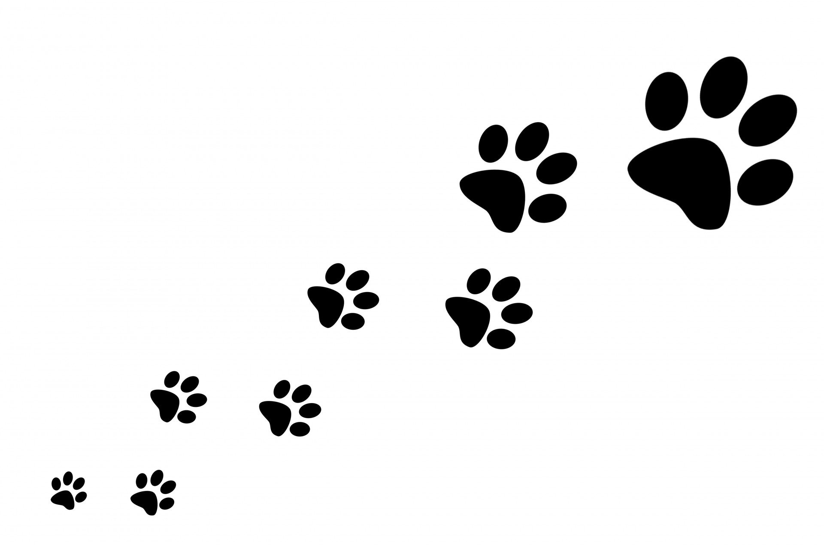
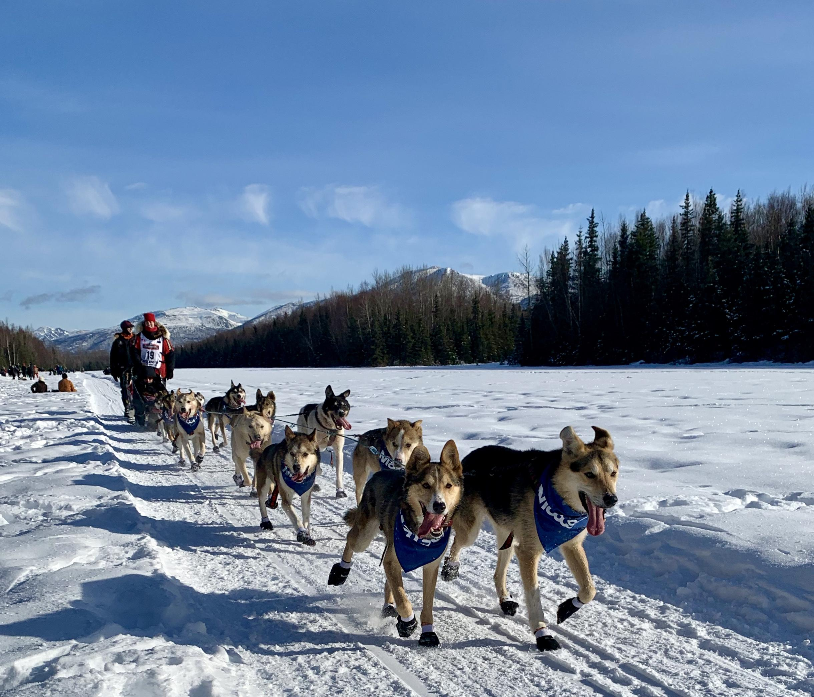
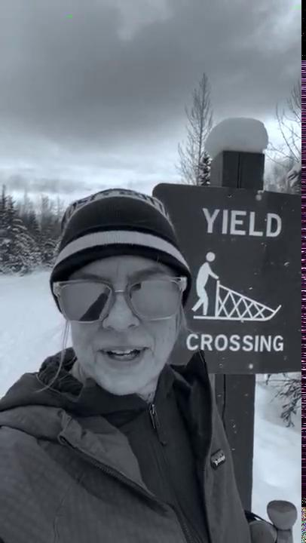
The Iditarod Virtual PE Challenge!
Frau Wiley introduces the Iditarod unit from the trail!
Aliy Zirkle and team in Anchorage. Photo by Lisa Wiley

Slide 2
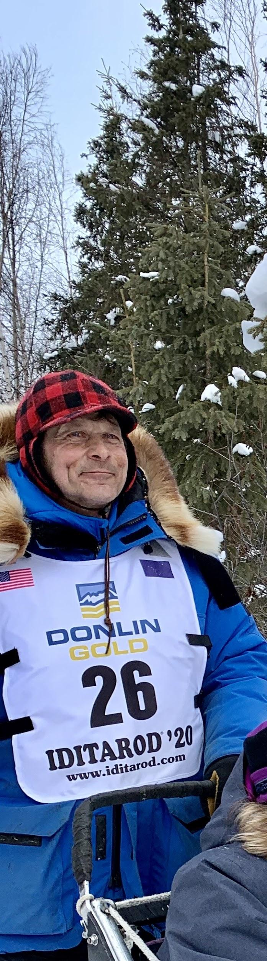
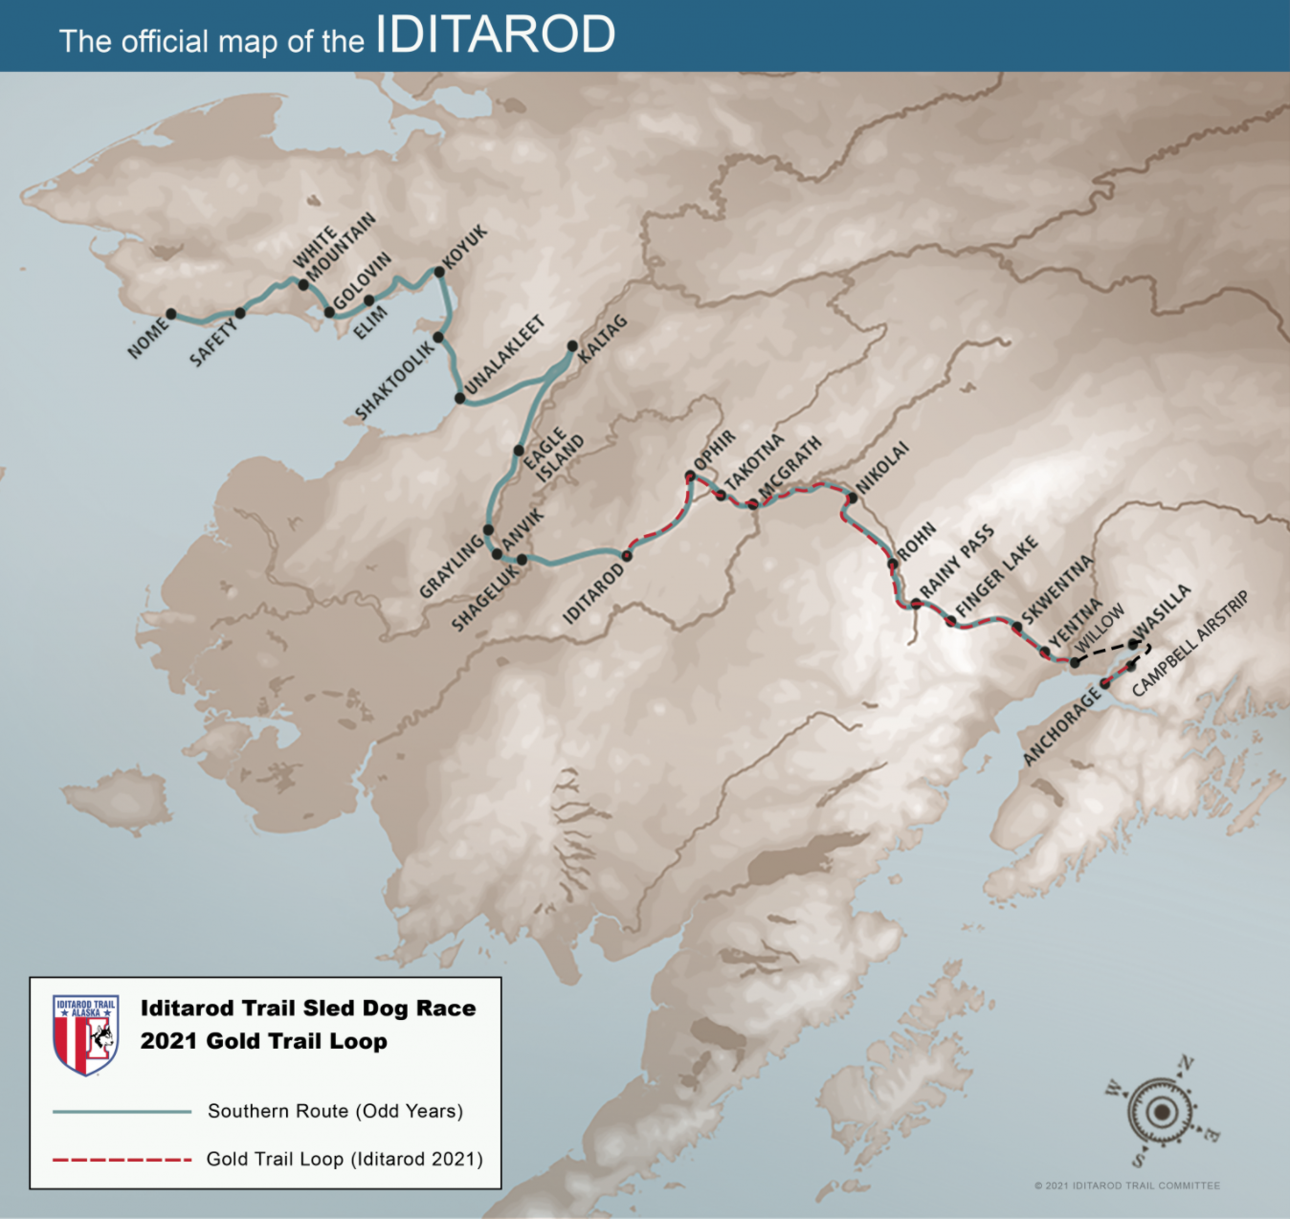
Mushing champion Martin Buser Photo by Lisa Wiley
2021 Iditarod is on the Gold Trail Loop for the first time ever. Image from Iditarod

Slide 3
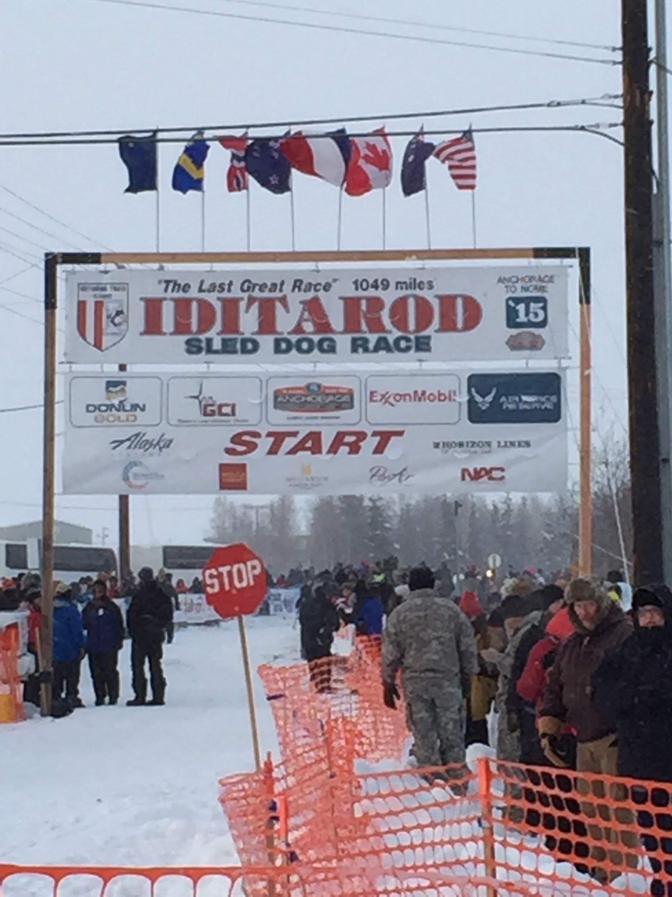
It’s Iditarod Season!
Every year on the first Saturday in March, the most famous and difficult sled dog race in Alaska begins.
We are going to use this year’s race to get inspired, to learn about the history and route of the race, and to work on our fitness.
We will have several challenges to complete during this unit, which starts in late February and ends on March 19th.
Let the enthusiasm of the sled dogs inspire you to complete all of the Iditarod Challenges and turn in the Checklist when done for PE credit!
Photo by Lisa Wiley, Fairbanks, AK

Slide 4
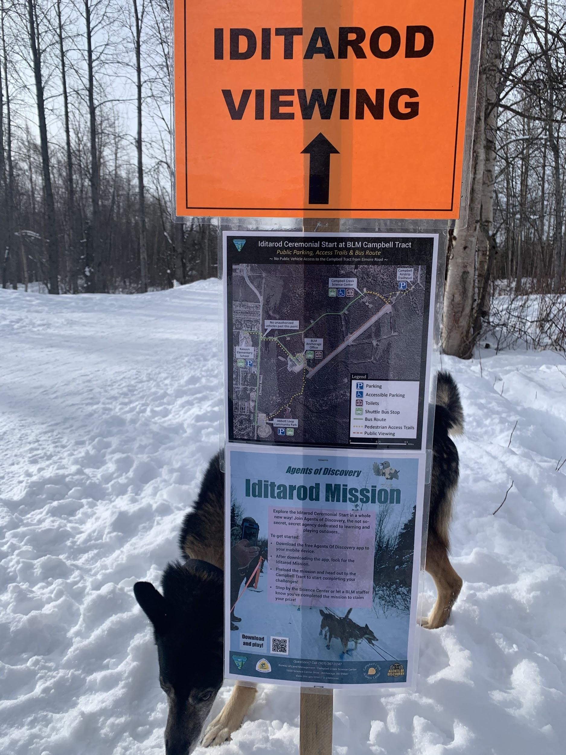
Challenge #1: Walk on a trail
Iditarod Route: Deshka to Skwentna mile 83. Start of the race!
The National Historic Iditarod Trail was created by Joe Redington, Sr., in part to preserve the traditional gold route from Seward to Nome. He also created the race to preserve the sport of dog mushing. Here you can learn about the history of the amazing, historic trail: https://www.blm.gov/programs/national-conservation-lands/national-scenic-and-historic-trails/iditarod
Please check out this interactive map of the traditional trail so you can see how long it is, as well as how the trail is mostly forged in deep wilderness.
https://blm-egis.maps.arcgis.com/apps/webappviewer/index.html?id=12fef9ac3f80453dae25d171246c327d
Photo by Lisa Wiley, Anchorage, AK

Slide 5
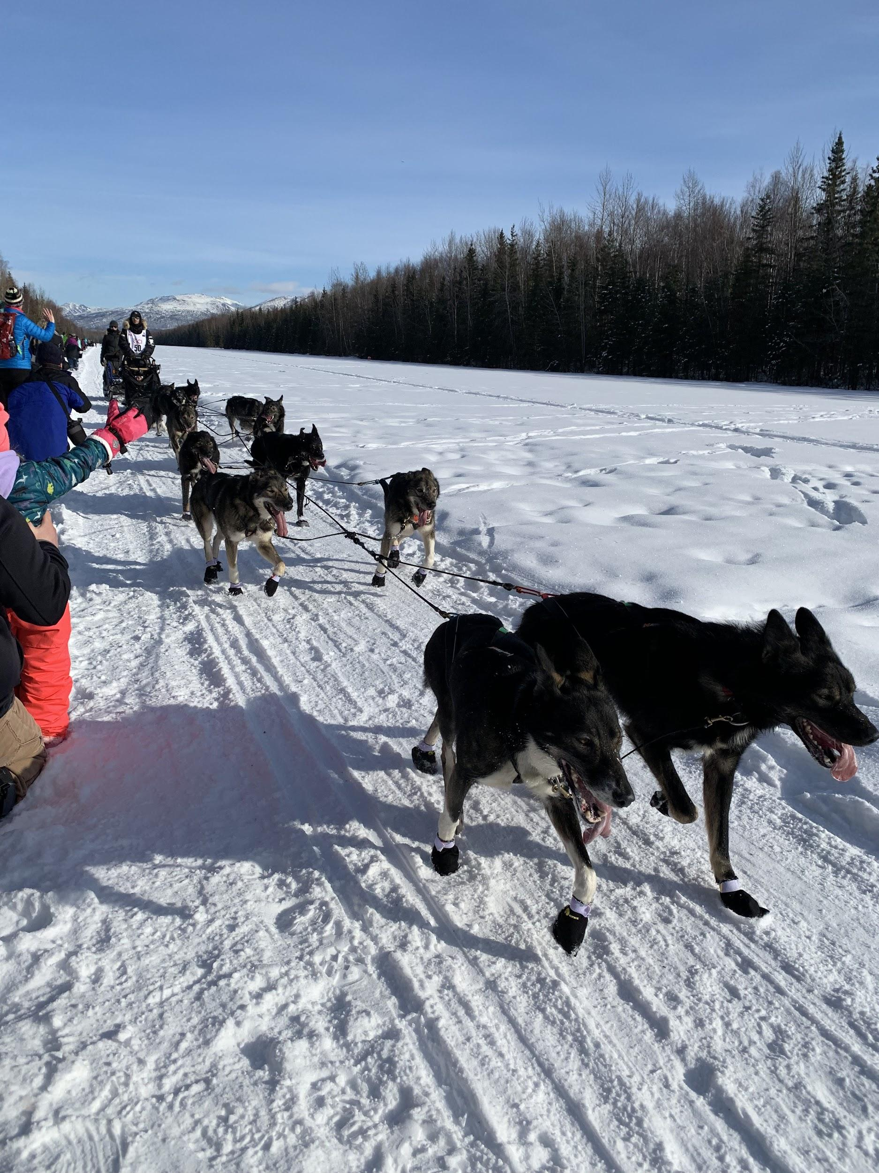
Challenge #1: Walk on a trail
The Challenge: If possible, find a trail close to your house to walk on with your family. You may even be able to walk on the historic Iditarod trail since it winds throughout Anchorage.
Your walk could be around your block or in your house on a treadmill if you can’t make it to a trail.
To show you have completed this assignment, please take a photo on your walk and submit it to the assignment: Challenge #1. Describe your location.
The Iditarod Trail at Campbell Airstrip in Anchorage. Photo by Lisa Wiley

Slide 6
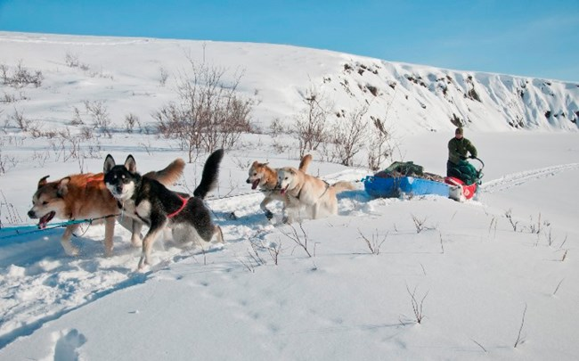
Challenge #2: Alaska Range: Climbing
Iditarod Route: Skwentna to Rainy Pass (stop at Finger Lake) mile 153
Rainy Pass is one of the few passes through the majestic Alaska Range. It’s also the home of the oldest hunting lodge in Alaska.
To get to this point, you and your dog team have had to climb some serious elevation. For this challenge, it’s time to climb!
Photo from Google images

Slide 7
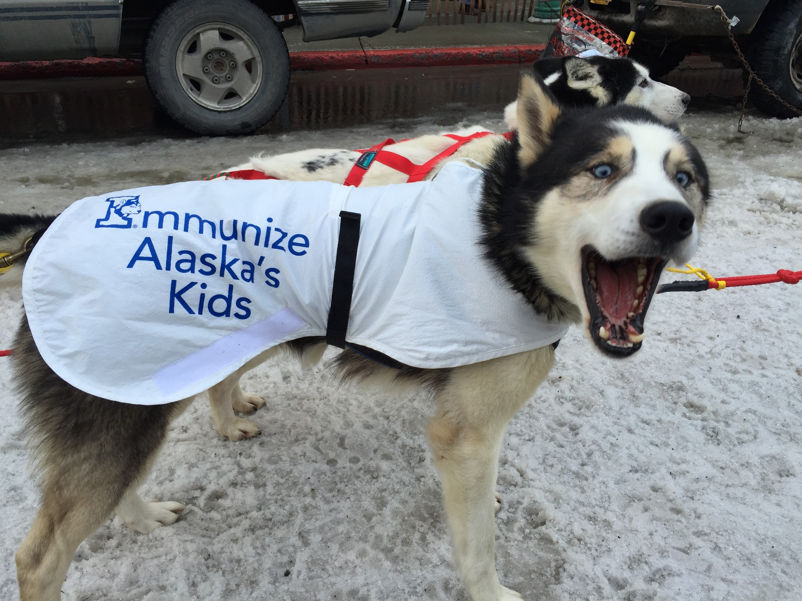
Challenge #2: Alaska Range: Climbing
The Challenge Options:
Climb the stairs at your house for at least 10 to 20 minutes, up and down.
Pick a trail near your house that has elevation gain and hike up for at least 20 minutes.
Go to the climbing gym with your family.
Climb on playground equipment
Do High Knees walking in place
To show that you have completed this assignment, check off the challenge on the Iditarod checklist. (I trust you!)
Photo by Lisa Wiley, Anchorage, AK

Slide 8
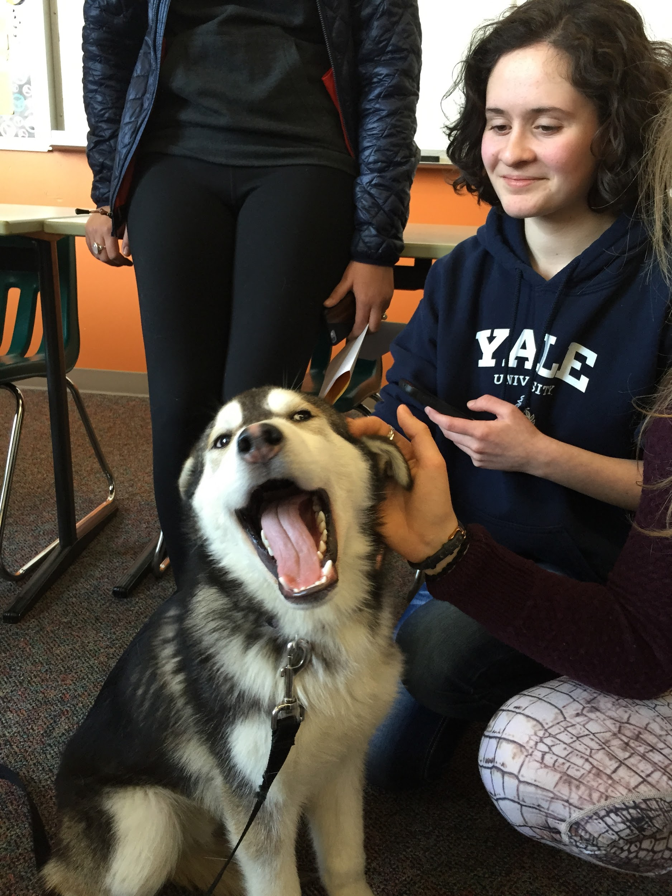
Challenge #3: Sledding, skiing, or tubing
Iditarod route: Rainy Pass to Nikolai (stop in Rohn) Mile 263
This part of the Iditarod route is one of the most famous parts of the race, as the mushers descend the Dalzell Gorge.
Check out this video of Jeff King descending the Gorge one year when there wasn’t much snow. Yikes!: https://www.youtube.com/watch?v=dAHa-6VkUQY
The adorable and friendly dog Thunder from Scott Janssen’s team visiting Frau Wiley’s class. Photo by Lisa Wiley

Slide 9
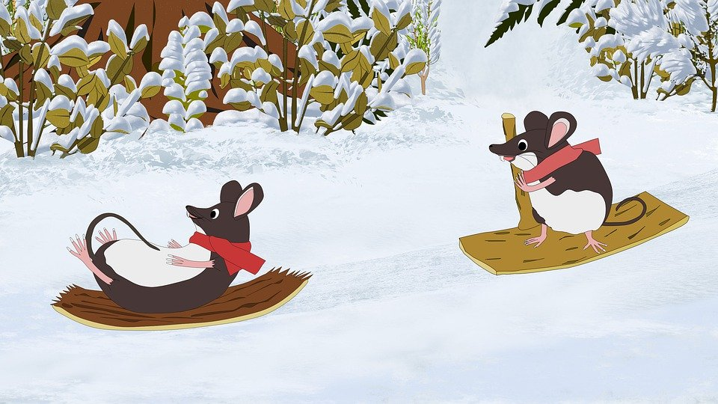
Challenge #3: Sledding, skiing, or tubing
The Challenge Options
For this challenge, you can do an activity where you sled, ski, tube, or otherwise play with descending a steep slope, while under control. Please be safe!
To show that you have completed this assignment, please check off the challenge on the Iditarod checklist.
Photo from Google Images

Slide 10
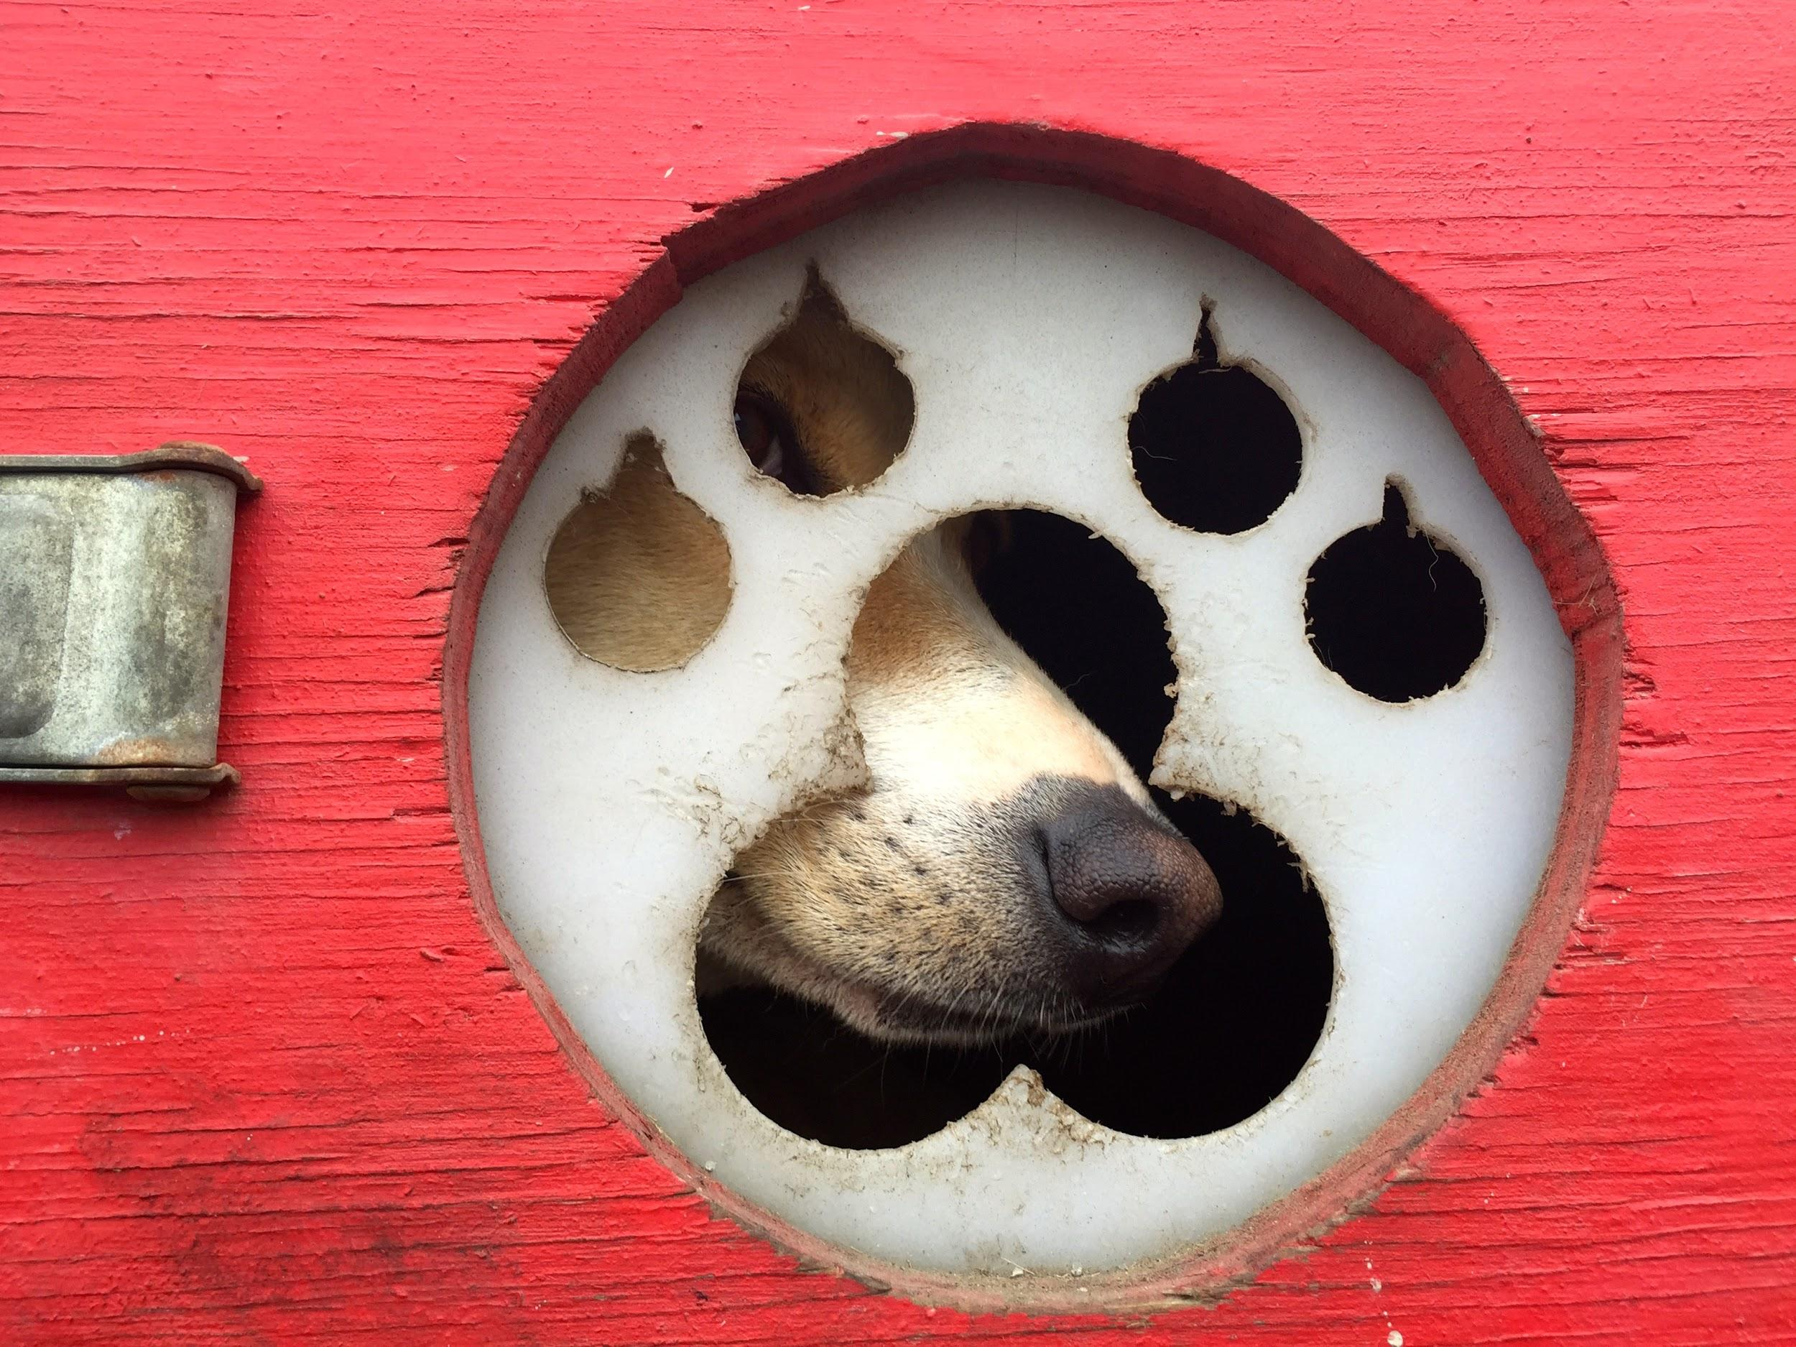
Challenge #4: Rest, Hydrate, and Self Care
Iditarod Route: Nikolai to Ophir (stop in McGrath) Mile 352
In a traditional Iditarod race, mushers will start taking their mandatory 24 hour rests at around this stage in the race. This is a chance to catch up on sleep, do repairs, and take care of dogs (always the #1 priority).
Some of these checkpoints have extra incentives, like gold nuggets, cash, or gourmet dinners, if you are the first musher to arrive. Some of the checkpoints are also famous for their food. Mushers look forward to eating and recovering.
Photo by Lisa Wiley

Slide 11
Challenge #4: Rest, Hydrate, and Self Care
The Challenge: Answer the questions after doing some research and rest
How much sleep do mushers get during the Iditarod? How do they handle sleep deprivation?https://www.qrillpaws.com/news/how-dallas-seavey-managed-9-days-of-racing-on-17-hours-of-sleep
How much water do you need a day when outdoors on a cold day? https://www.trainingpeaks.com/blog/4-hydration-tips-cold-weather-endurance-training/
3. How many calories does a dog need daily during the race? https://www.petfoodinstitute.org/the-whole-bowl/iditarod-sled-dog-nutrition-qa-with-an-iditarod-veterinarian/
Now, get some good rest, drink plenty of water, and eat healthy food today:) To show that you have completed this assignment, please check off the challenge on the Iditarod checklist.

Slide 12
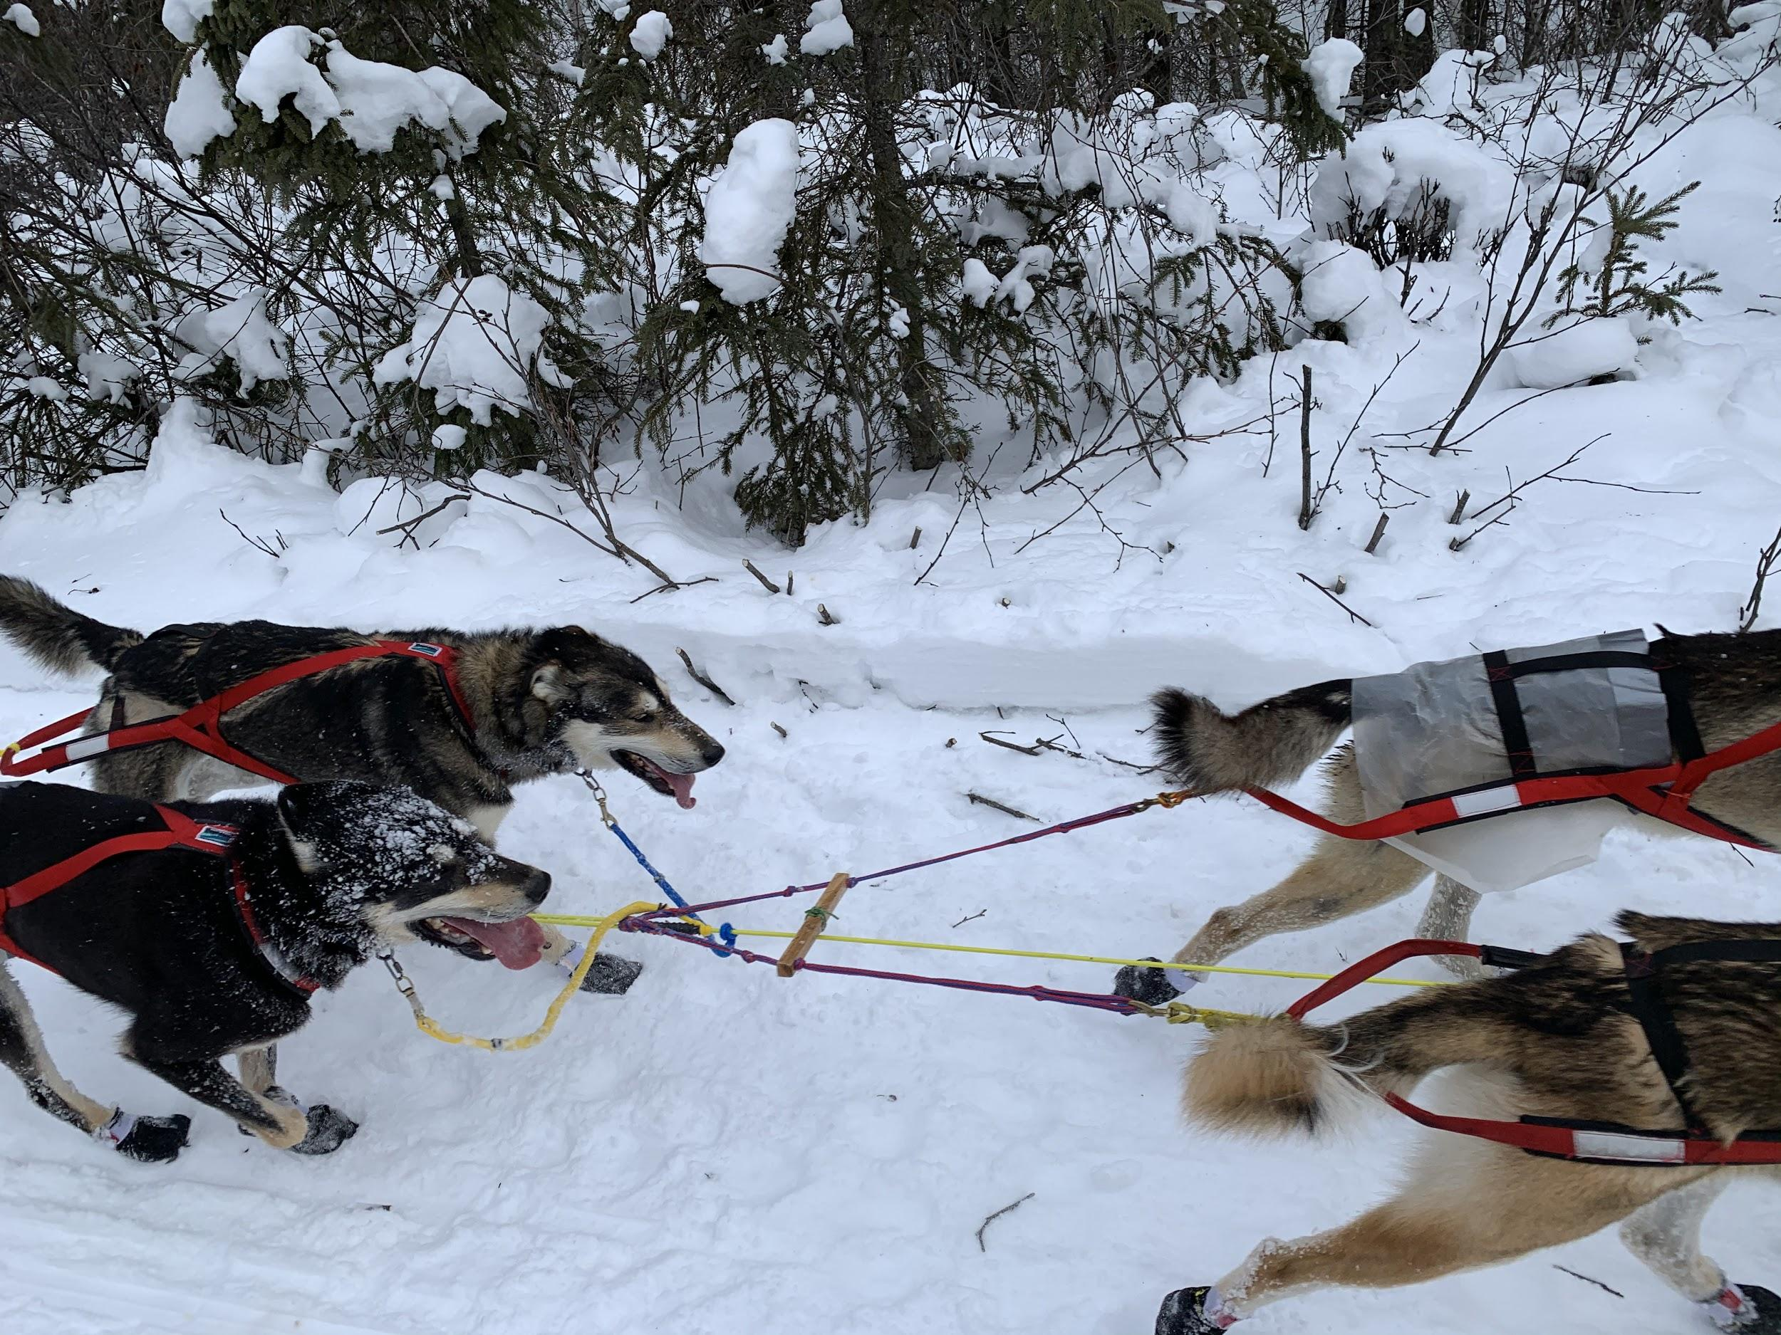
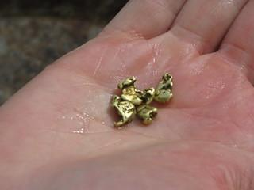
Challenge #5 Squats
Iditarod Route: Ophir to Iditarod and turn around for the return! ½ way done! Mile 442
Iditarod is an old abandoned gold mining town. It’s also this year’s ½ way point. Check out this link for historical information: https://iditarod.com/iditarod-gold-rush-to-ghost-town/
The musher who is winning at this point gets an award of a handful of gold nuggets!
Photo by Lisa Wiley
Image from Google Images

Slide 13
Challenge #5 Squats
The Challenge: Squats
IF you are a dog musher,, you will have to bend over to change countless dog booties, do sled repairs, feed your dogs, etc.. For today’s challenge, practice your favorite squats. Watch the video below for proper technique. Repeat the squats 10 times in 1 to 3 sets.
Here is a video that shows you how to safely do squats: https://www.google.com/search?q=video+of+squats+exercise&oq=video+of+squats&aqs=chrome.1.69i57j0l2j0i22i30l7.6441j0j7&sourceid=chrome&ie=UTF-8#kpvalbx=_vNkiYM6YLY_z-gSQg5X4Dw11
To show that you have completed this assignment, please check off the challenge on the Iditarod checklist.

Slide 14
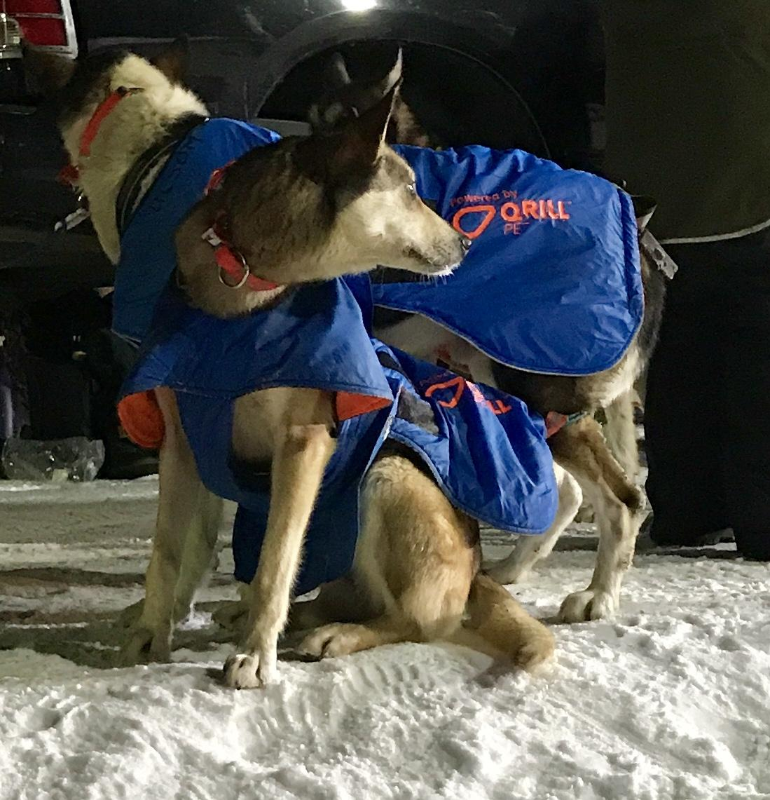
Challenge #6 Jumping Jacks with Outdoor Gear
Iditarod Route: Ophir to Nikolai (Stop at McGrath) mile 611
How do mushers handle the extreme cold of this race for so many days outdoors?
There are many cold weather injuries and dangers to avoid, including frostbite and hypothermia. Check out this video about what hypothermia does to your brain and body to learn about it: https://www.youtube.com/watch?v=-JAXbDTIiSk
Learning how to dress properly in layers with good gear is essential to survive this race with all your fingers and toes intact. Here is an article from Iditarod about what mushers usually wear: https://iditarod.com/edu/moments-with-mushers-clothing/
Photo by Lisa Wiley

Slide 15
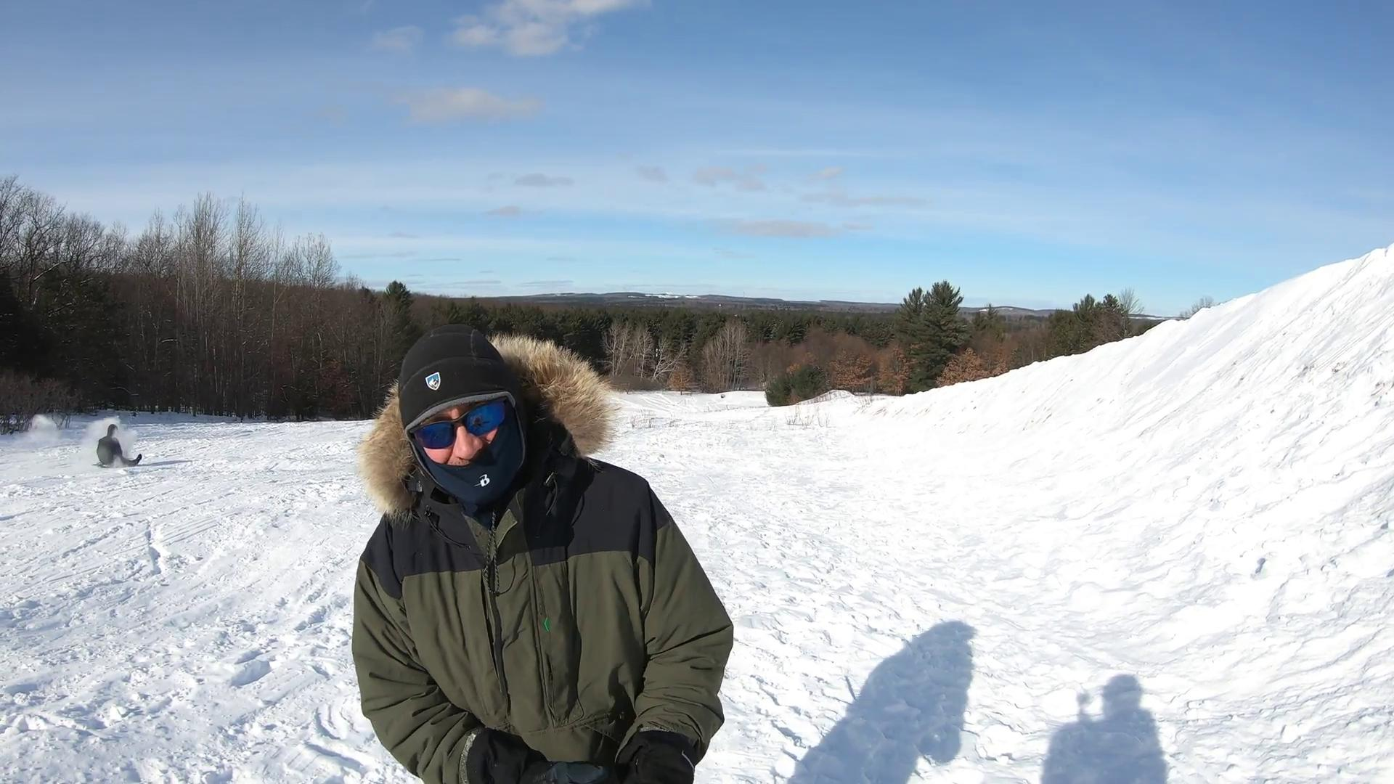
Challenge #6 Jumping Jacks with Outdoor Gear
The Challenge:
Dress as if you were going to race the Iditarod. Put on all the warm, appropriate clothes that you have available. Then, go outside and do 20 jumping jacks wearing all the heavy clothes.
Submit a photo under Challenge #6 that shows you doing the jumping jacks with all your winter clothes on:) Make sure your amazing face is visible in the photo:)
Iditarod Veteran and prior Rilke Schule teacher Herr Bearrs demonstrates jumping jacks wearing his mushing jacket, all the way from Michigan!

Slide 16
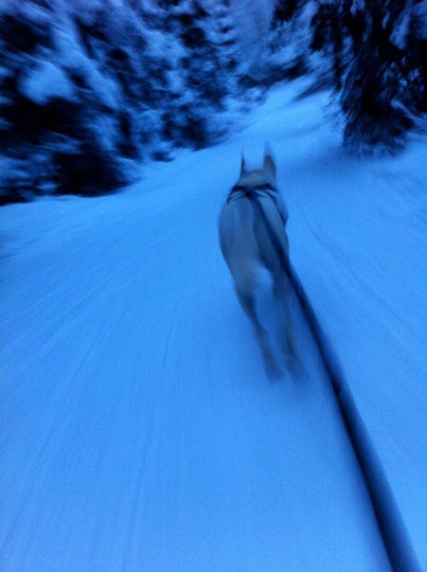
Challenge 7--Loose Dog! Running Challenge!
Iditarod Route: Nikolai to Rainy Pass (stop at Rohn) mile 721
Most mushers have some kind of problem along the trail to solve.
Here is a story about a husky who escaped from her team and ran home by herself! https://www.wkrn.com/news/runaway-sled-dog-found-in-alaska-after-month-long-journey/1091711727/
Photo by Lisa Wiley

Slide 17
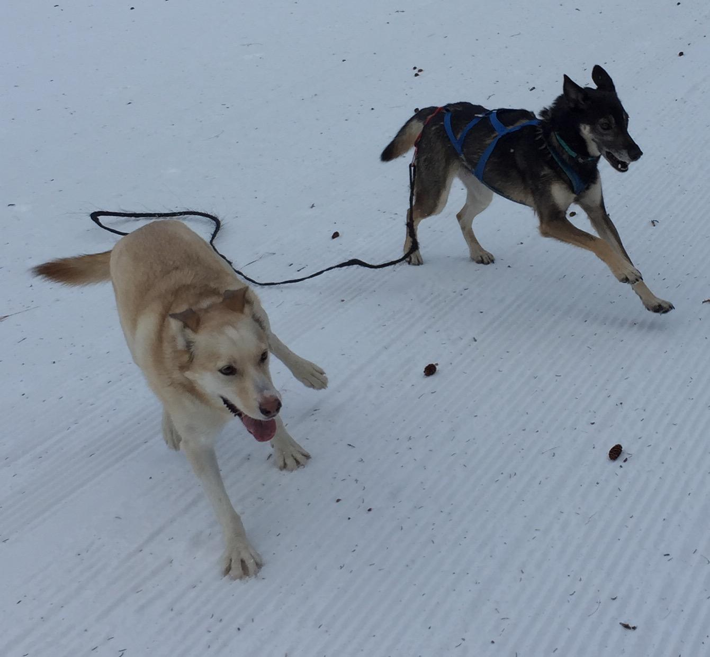
Challenge 7--Loose Dog! Running Challenge!
The Challenge:
For today’s challenge, pretend that one of your sled dogs escaped, and you have to chase him/her down. Huskies are some of the best runners on the planet. Good luck catching the dog!
Run for at least 20 minutes, indoors or outdoors. It’s ok to do in intervals if needed.
To show that you have completed this assignment, please check off the challenge on the Iditarod checklist.
Photo by Lisa Wiley

Slide 18
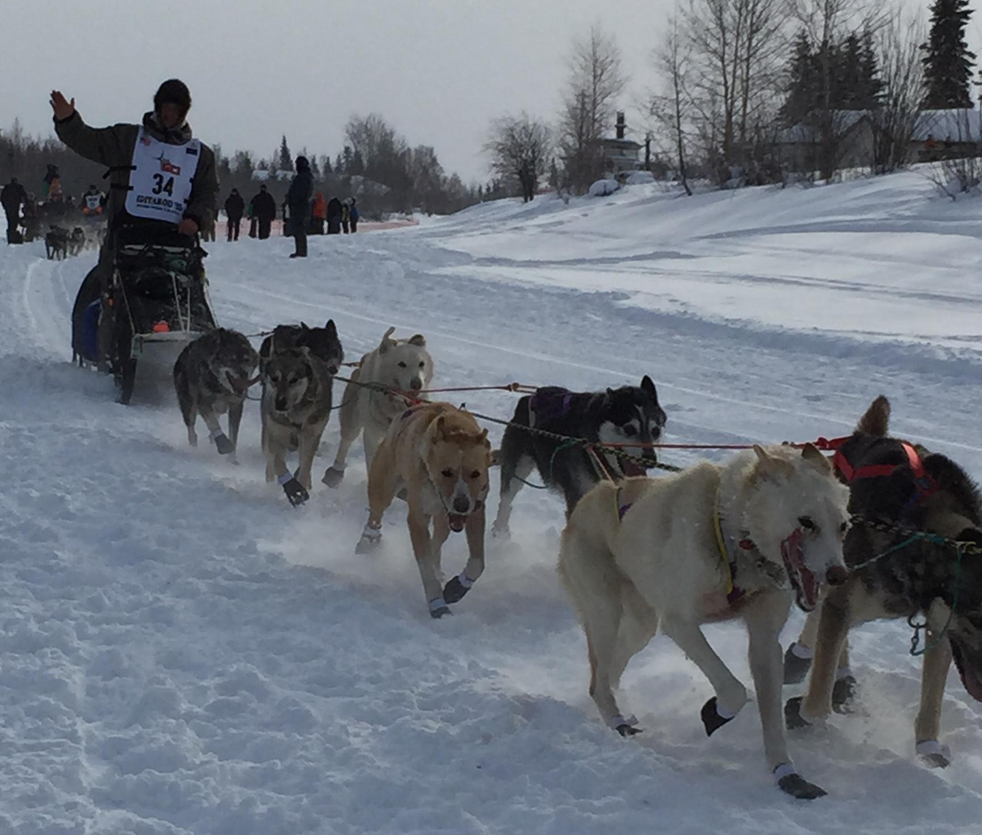
Challenge #8--Core workout
Iditarod Route: Rainy Pass to Skwentna (stop at Finger Lake) mile 791
You are almost home. Your dogs are probably picking up the speed as they can sense they are coming closer to their cozy houses!
Your body and mind are exhausted from the work of the race, especially your core from balancing on the sled for so many miles. Time to work that core to help you end the race strong!
Photo by Lisa Wiley Fairbanks, AK

Slide 19
Challenge #8--Core workout
The Challenge:
Time for core crunches!
Lay flat on your back on a comfortable surface. Bring your hands either behind your hand with your hands clasped or underneath your hips if you have back pain. Bend your knees. Then, curl your head towards your knees as you lift your knees towards your head. Then extend your body open. Repeat. Do at least 3 sets of 10 core crunches to complete this challenge.
To show that you have completed this assignment, please check off the challenge on the Iditarod checklist.
Do you recognize former this former Iditarod finisher and Rilke Schule teacher? Photo from Bryan Bearrs

Slide 20
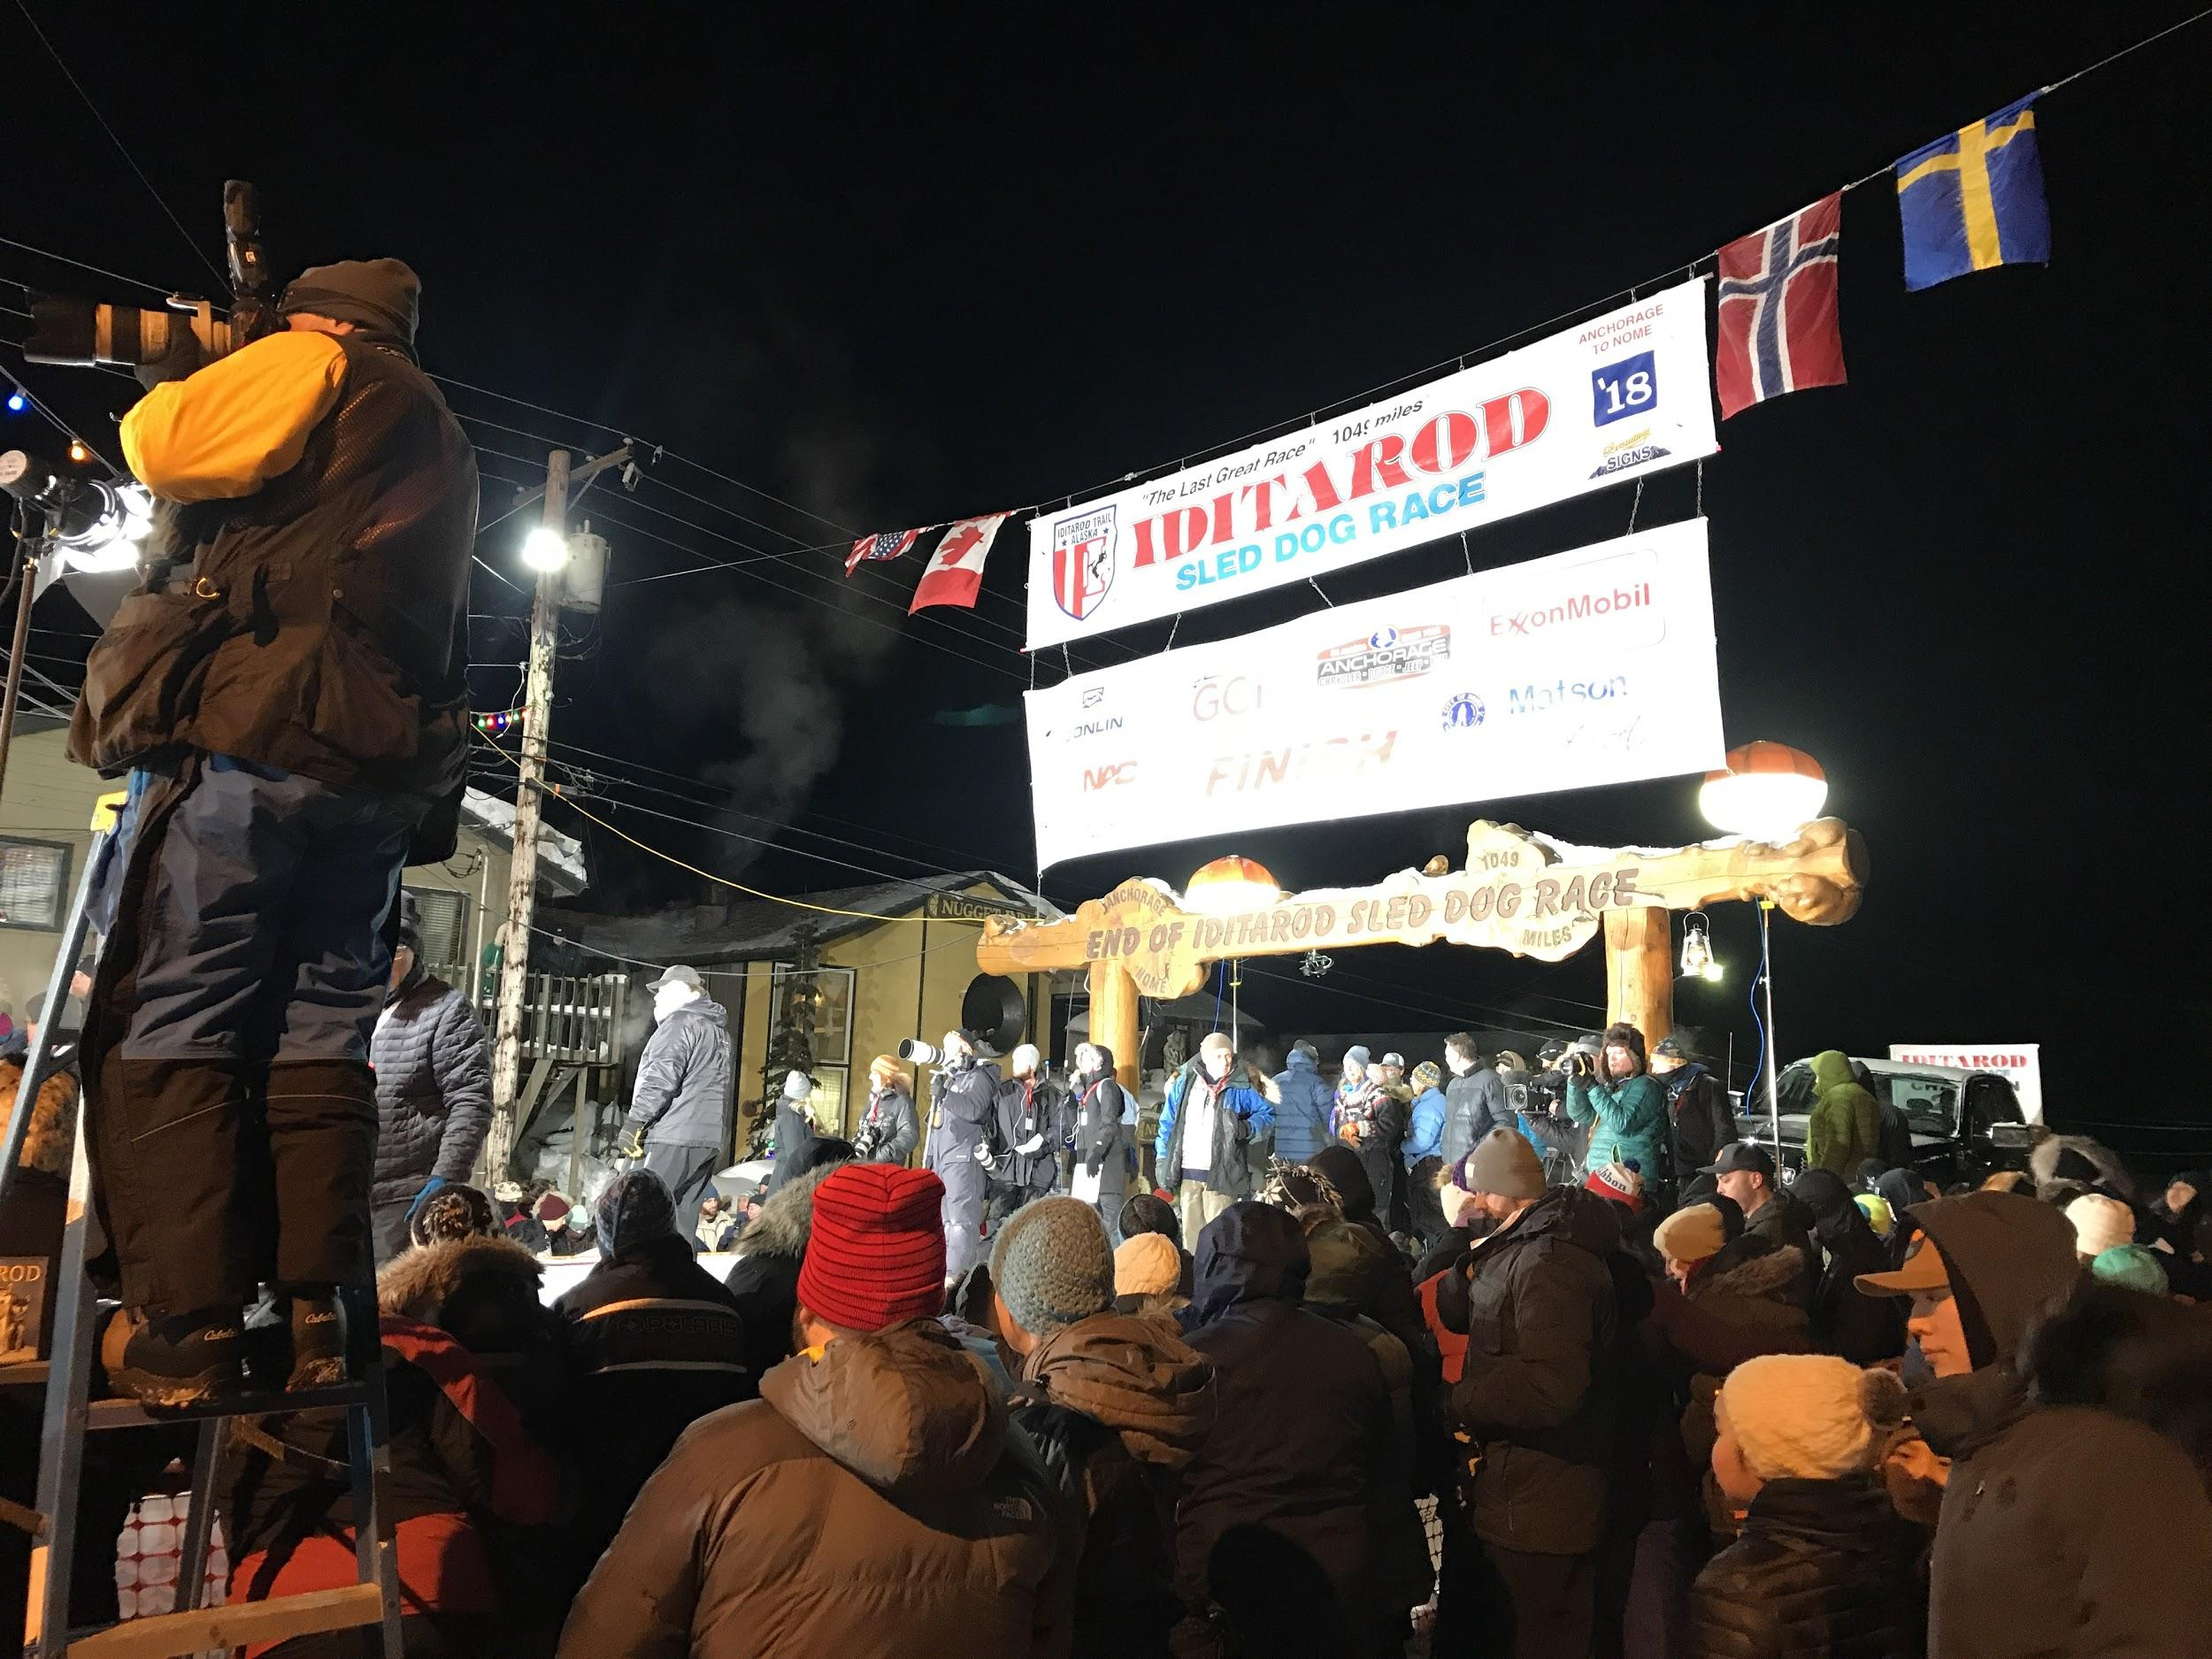
Challenge #9--The Finish Line! Endurance Goals
Iditarod Route--Skwentna to Deskha Landing--Mile 858
No matter what place they come in, finishing the Iditarod is a life goal for many dog mushers.
The race is a phenomenal test of physical endurance, wilderness survival skills, as well as dog care.
Do you have any large fitness goals that you would need to train for and devote a lot of time and discipline to succeed at?
Guess who won the Iditarod the year this photo was taken? Hint: look at the 2nd flag from the right.. Photo by Lisa Wiley

Slide 21
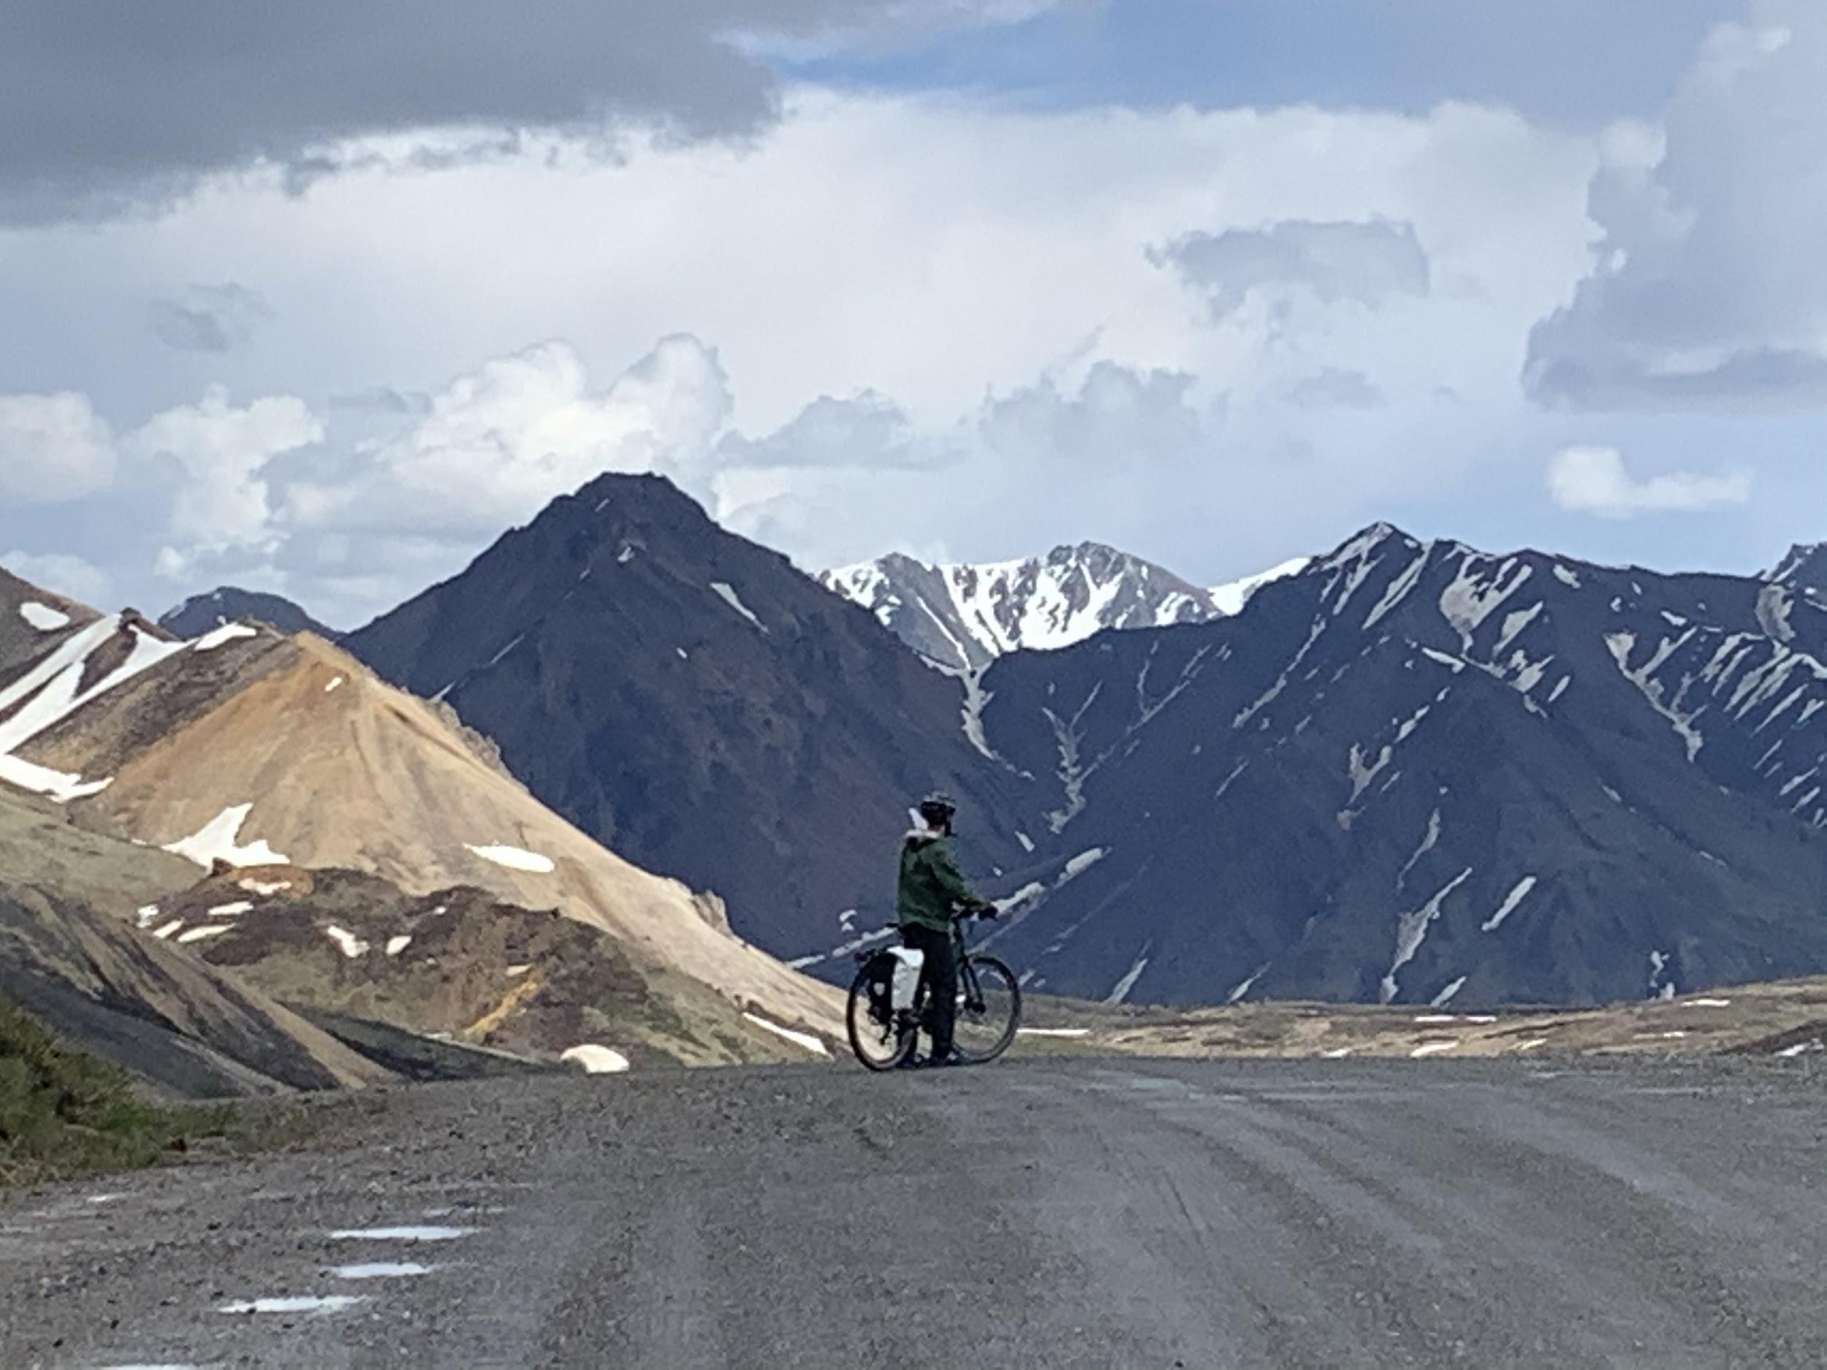
Challenge #9--The Finish Line! Endurance Goals
The Challenge
Pick a big fitness goal that you would like to complete at some point in your life and tell me about it.
This will go into Challenge #9 Assignment..
“Dream big and dare to fail!” Explorer Colonel Norman Vaughan
Create a short video or audio recording, telling me about your endurance goal. If possible, show yourself doing your sport in the video.
One of my endurance goals is to bike most of the roads in Alaska. I’m making good progress:) This is Denali National Park
Photo by Lisa Wiley.

Slide 22
Iditarod Checklist
Musher’s Name (That’s you!)__________________
Put a check next to the challenge when you complete it.
The full checklist will be due on March 19th at the end of the Iditarod unit. Challenge #1 and #6 are due by March 4th.
See the Iditarod PE Challenge Google Slides for more details on each challenge..
Challenge #1 _______Walk on a Trail (Submit a photo for this challenge) This assignment is due by March 4th.
Challenge #2_______ Climbing (Climb for at least twenty minutes)
Challenge #3_______ Sledding/skiing/Tubing (Ski, sled or tube for at least 20 minutes)
Challenge #4_______ Rest, Hydrate, Self Care (Answer the questions and rest)
Challenge #5_______ Squats (Do 3 sets of 10 squats minimum)
Challenge #6_______ Jumping Jacks Wearing Outdoor Gear (Do 20 jumping jacks wearing all your warm gear). Turn in a photo! This assignment is due by March 4th.
Challenge #7_______ Loose Dog Running Challenge (Run for at least 20 minutes. Can be in intervals).
Challenge #8_______ Core Workout (Do 3 sets of 10 crunches minimum)
Challenge #9_______ Endurance Goals (Record a short audio or video, telling me about an endurance goal you have. Include a demonstration of the sport if possible). This assignment is due by March 19th with the complete checklist.

Slide 23
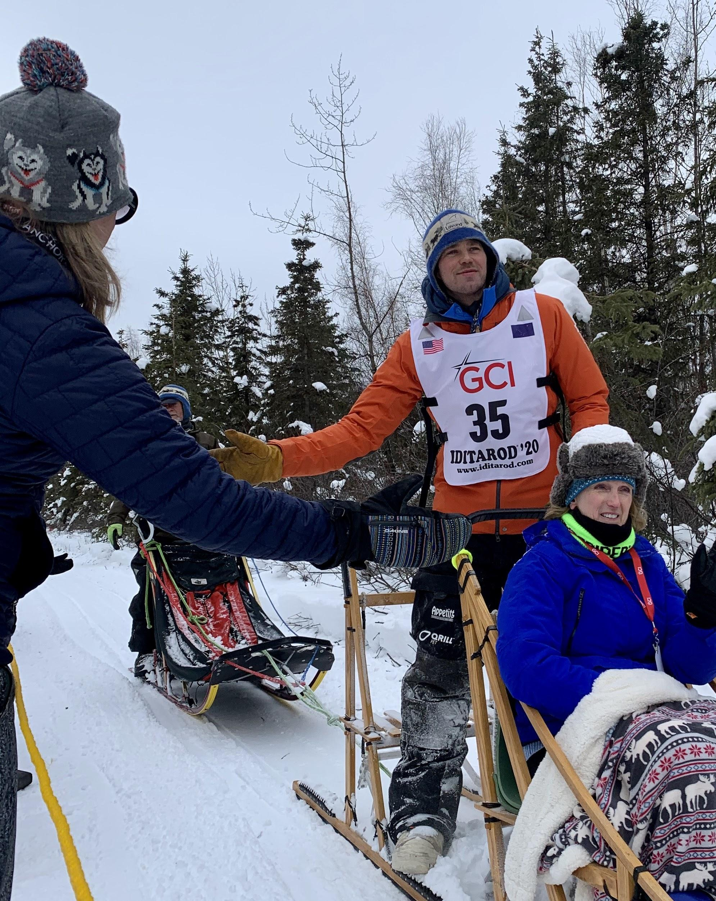
Thank you for your efforts during the Iditarod Challenge!
Iditarod champion Joar Leifseth Ulsom Photo by Lisa Wiley

