Slide 2
Type your answer here:

Slide 3
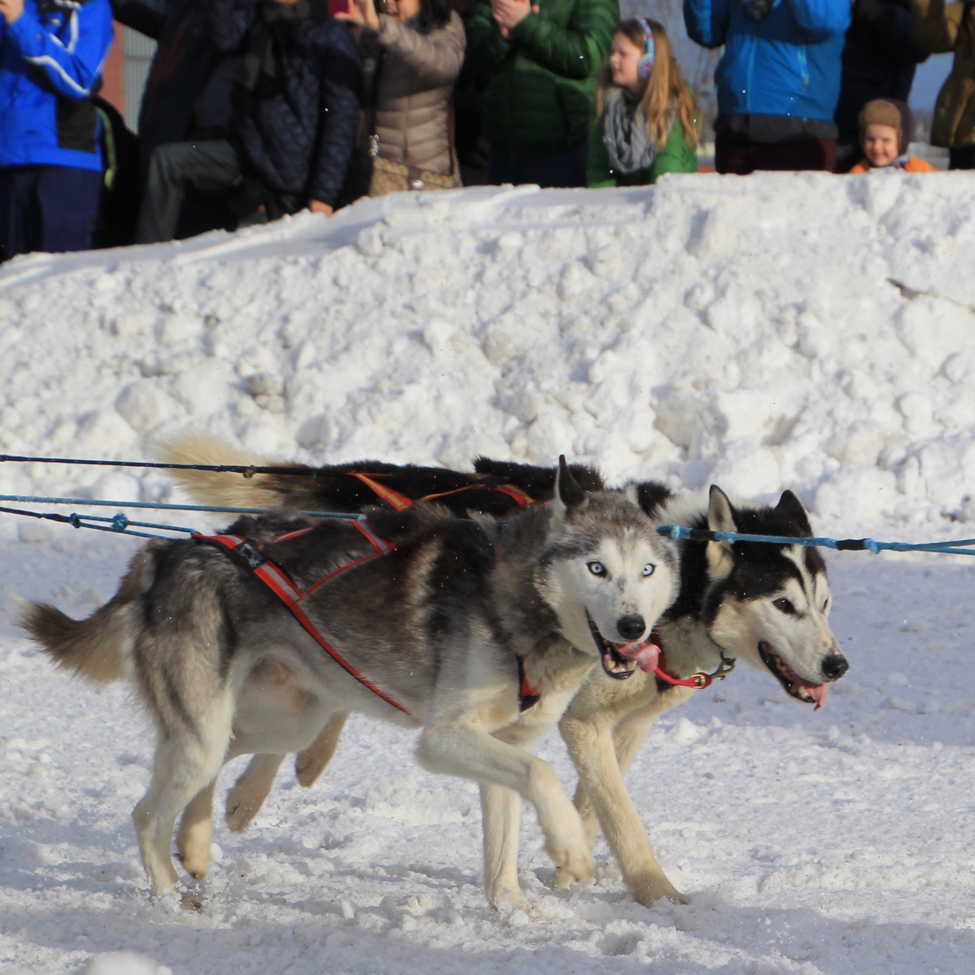
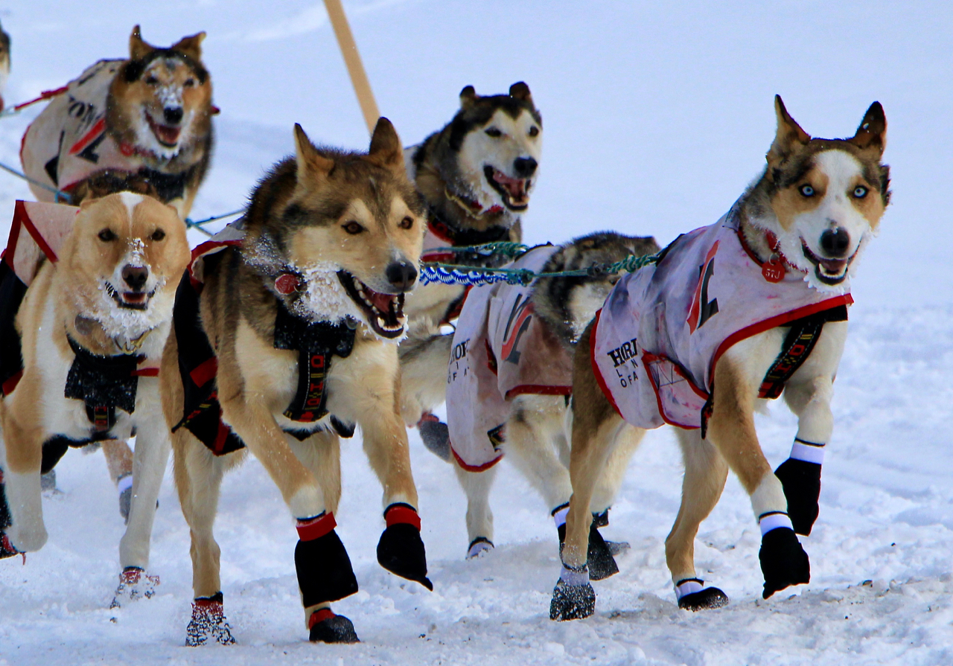
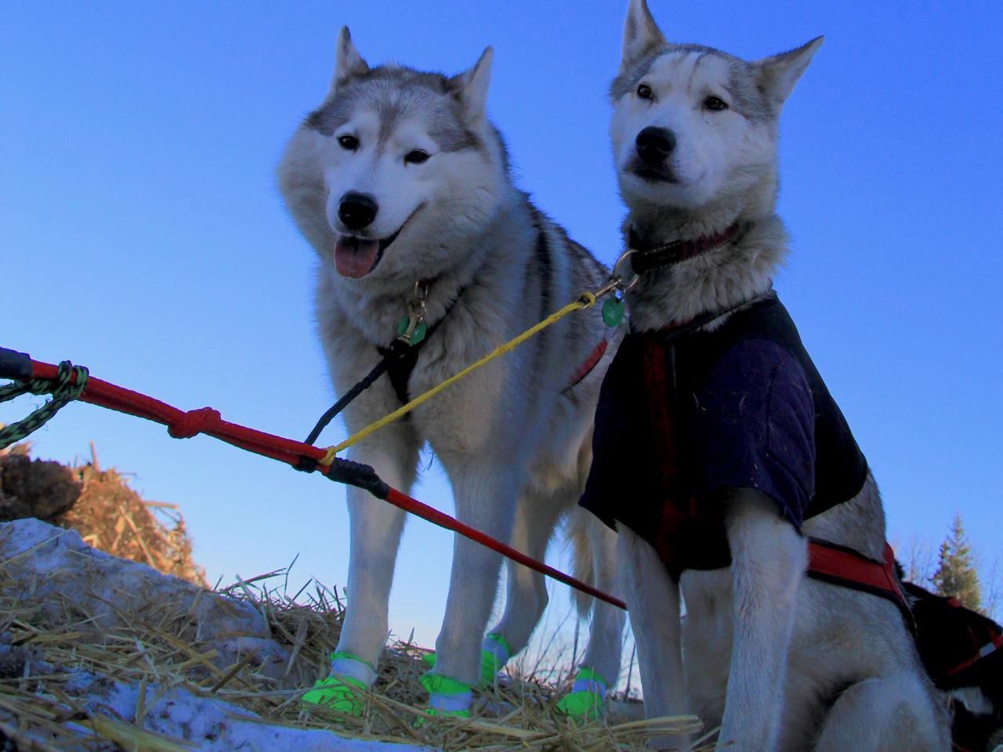
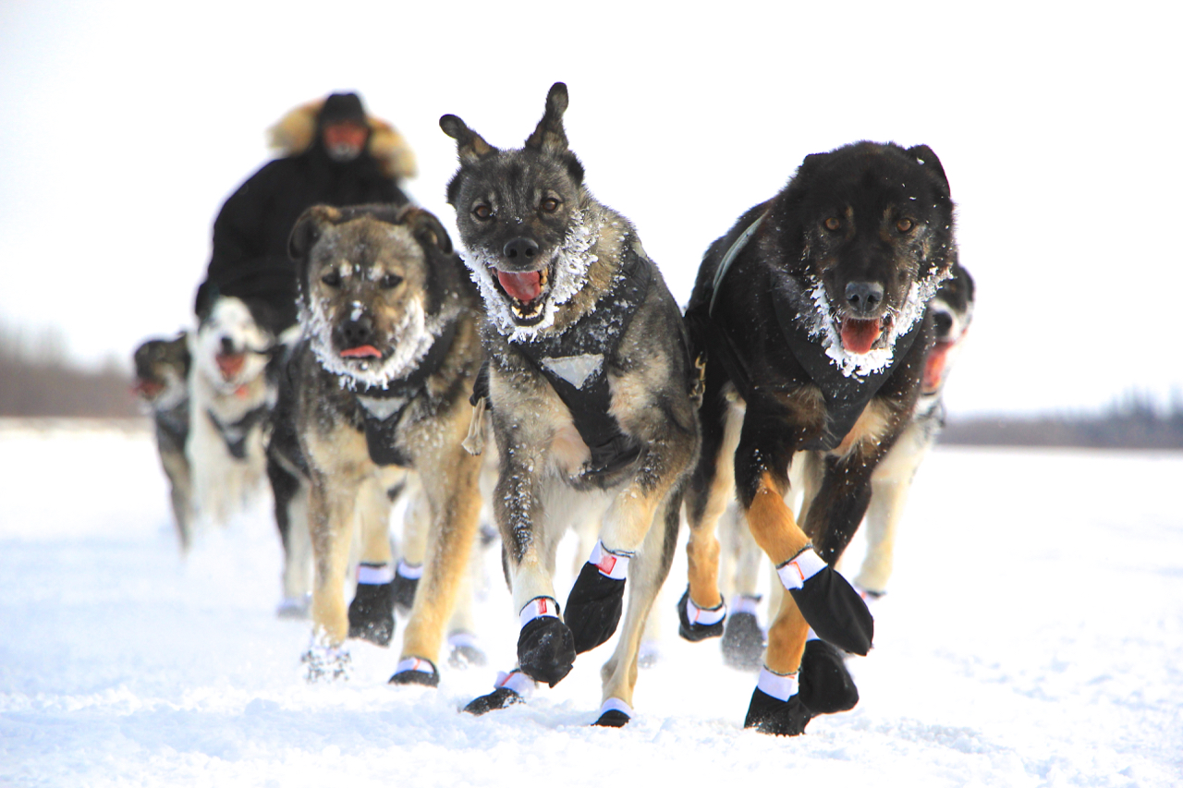

Slide 5
Alaskan huskies are big dogs
Siberians have tougher feet than Alaskans
Siberians are bigger and hairier than Alaskans
Siberians are bred for their looks
Siberians are too slow to run the Iditarod

Slide 6
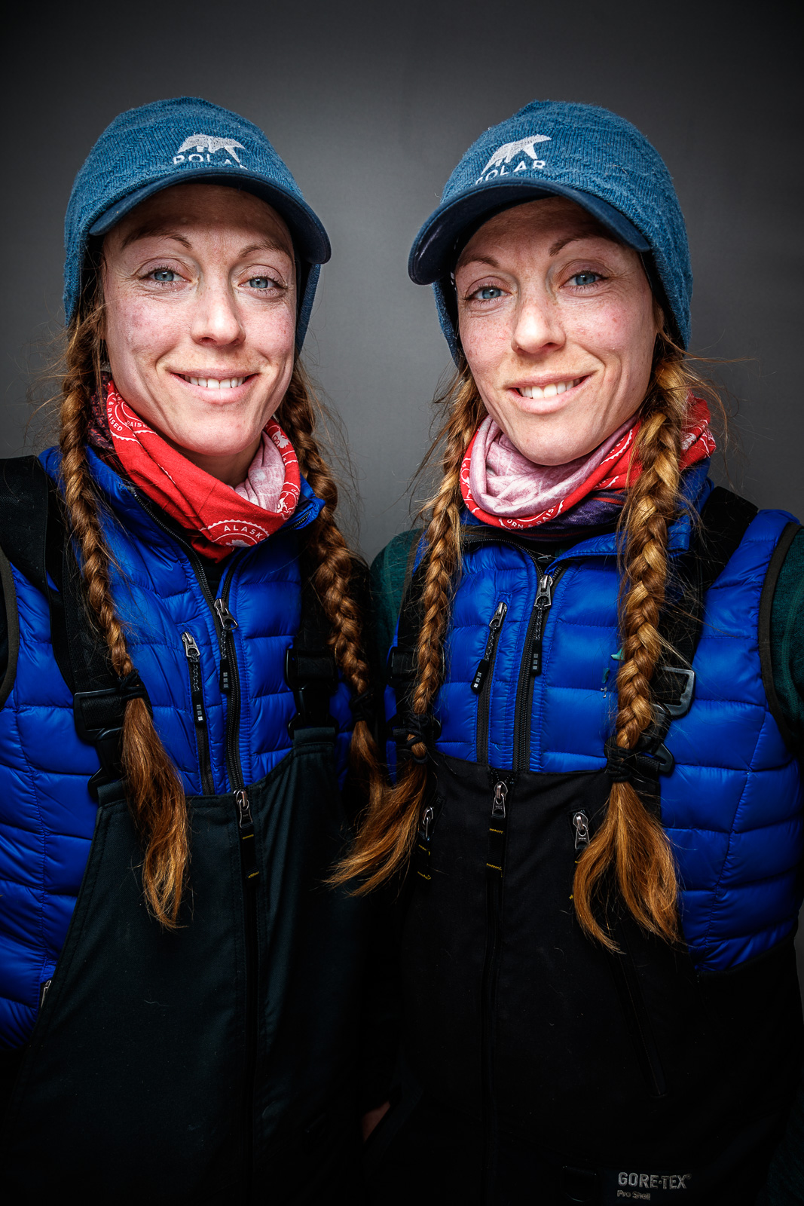
Ryan Redington
Lisbet Norris
Matthew Failor
Karen Ramstead
Hank Debruin
Aliy Zirkle
Rob Cooke
The Beringtons

