Slide 1
Directions:
Go through the slides and complete any activities that you see. There will be videos, links, questions to answer, etc. In order to watch the videos you must be in present mode. When you are ready to type your answers in the boxes, you must get out of present mode. Enjoy learning about The Elim 11. Note: make sure you are not in present mode for slide #6 or you won’t be able to see the directions.

Slide 2
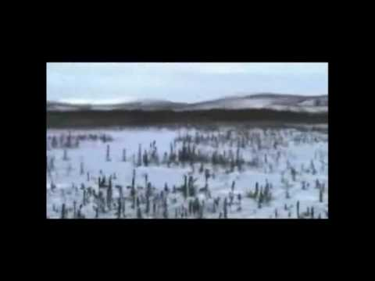
Watch the Iditarod Trail Song video to get your ready to learn more about the Iditarod.

Slide 3
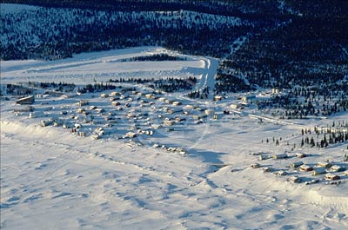
Click on the picture of Elim below. Read the article written by Sanka W. Dog that tells you all about the checkpoint of Elim. Answer the questions below when you are finished.
What is the only way to get to and from Elim?
What is the approximate population of Elim?

Slide 5
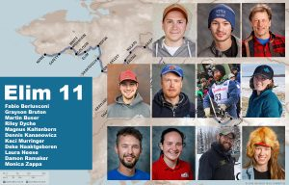
Click the picture of the Elim 11 and read the article by Zuma. Answer the questions when you are finished.
Why did the Elim 11 have to turn back and stay in Elim?

Slide 6
Directions: Click on the word “apply.” Find out how each of the Elim 11 finished. Rearrange their pictures on the line in the order of their finish.

Slide 7
Husky Talk: To listen to our recent podcasts with Laura Neese and Martin Buser, click on their picture.
Martin Buser
Laura Neese

