Slide 1
Phenomenon
What questions do you have?

Slide 2
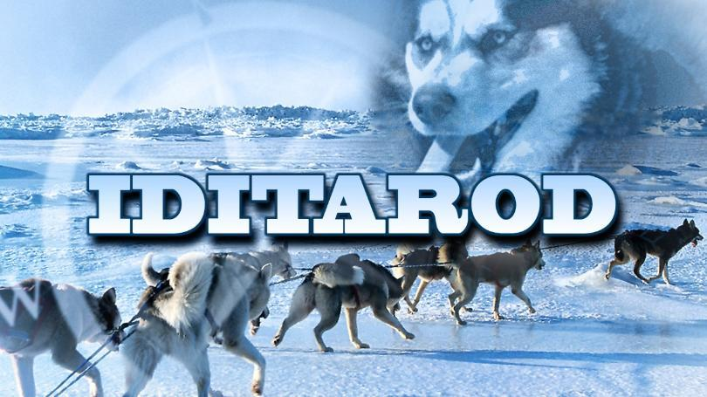
Idita-Science
Plan and Carry out an Investigation
Using Snow, Soil,and Rocks, determine which surface is the best and easiest for dogs to pull the sled on.

Slide 3
Testable questions we investigated
We investigated this question by...
Observations we observed...
My claim is...

Slide 4
In your science journal, draw a model of your investigation. Make sure that you label your drawing.

Slide 5
Challenge: Oh no!! You are mushing down the Iditarod Trail and your sled breaks. Using only the materials in front of you design and build a new dog sled. The sled has to be able to be pulled by dogs, slide on snow, and have a place for the musher to stand.

Slide 6
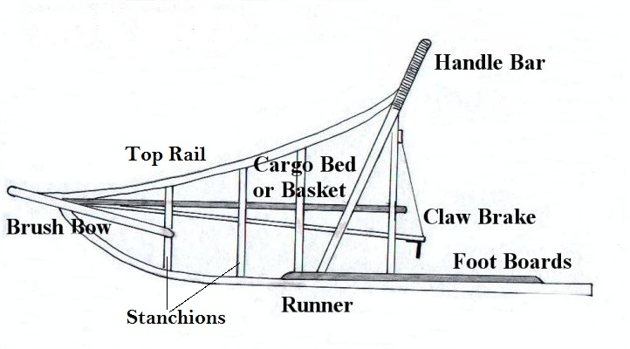
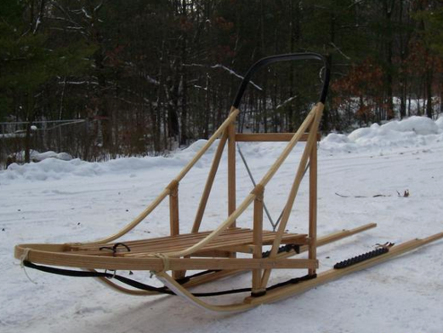

Slide 7
Label the cardinal directions of the map the mushers are traveling.

Slide 8
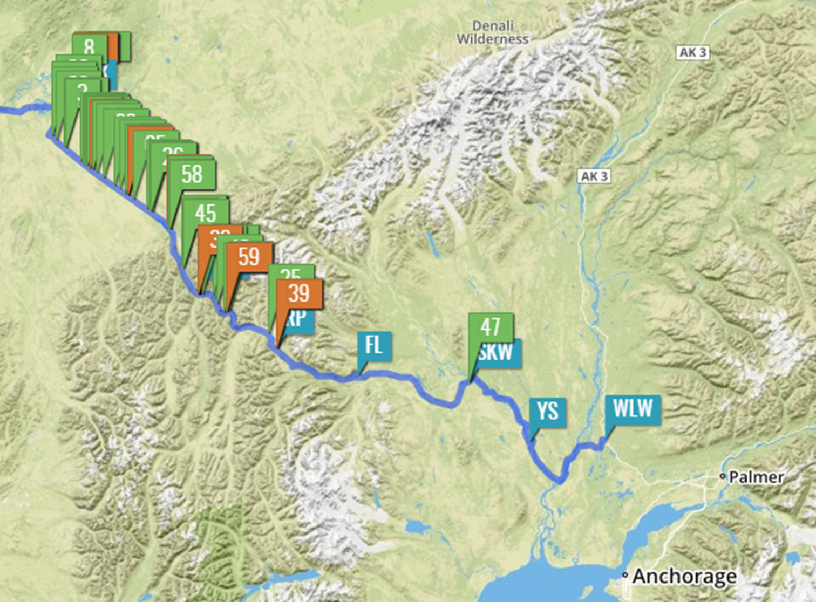
Label the landforms and water on this part of the trail.

Slide 9
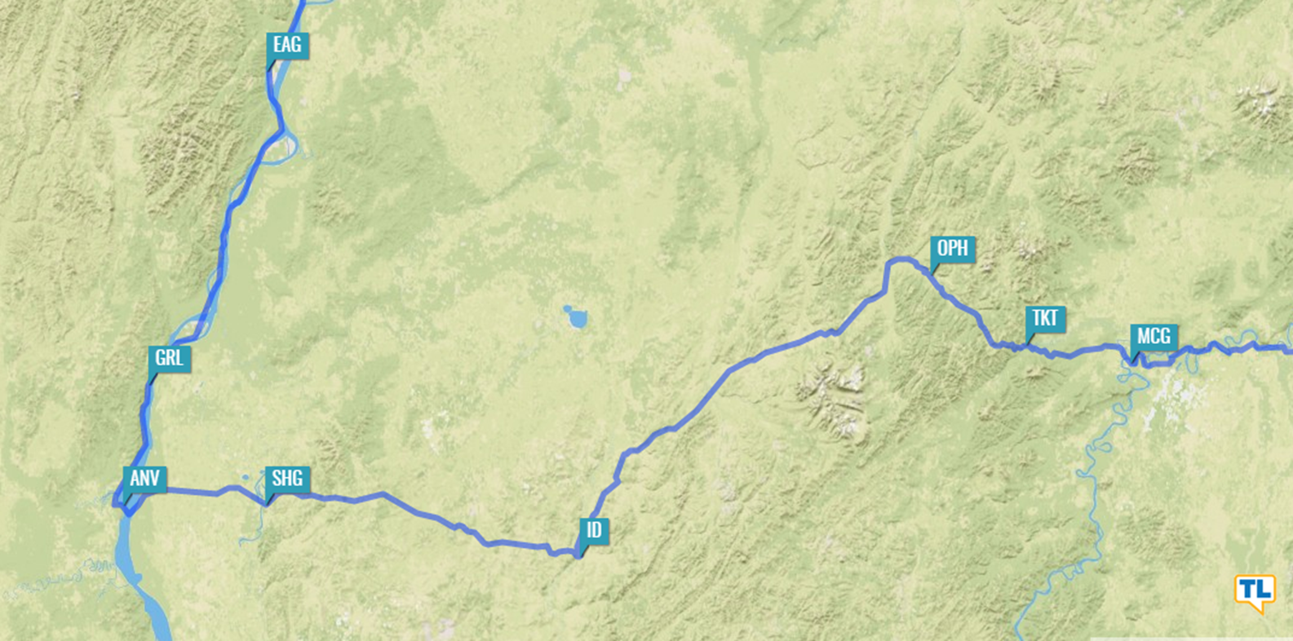
Label the directions on this part of the trail.

Slide 10
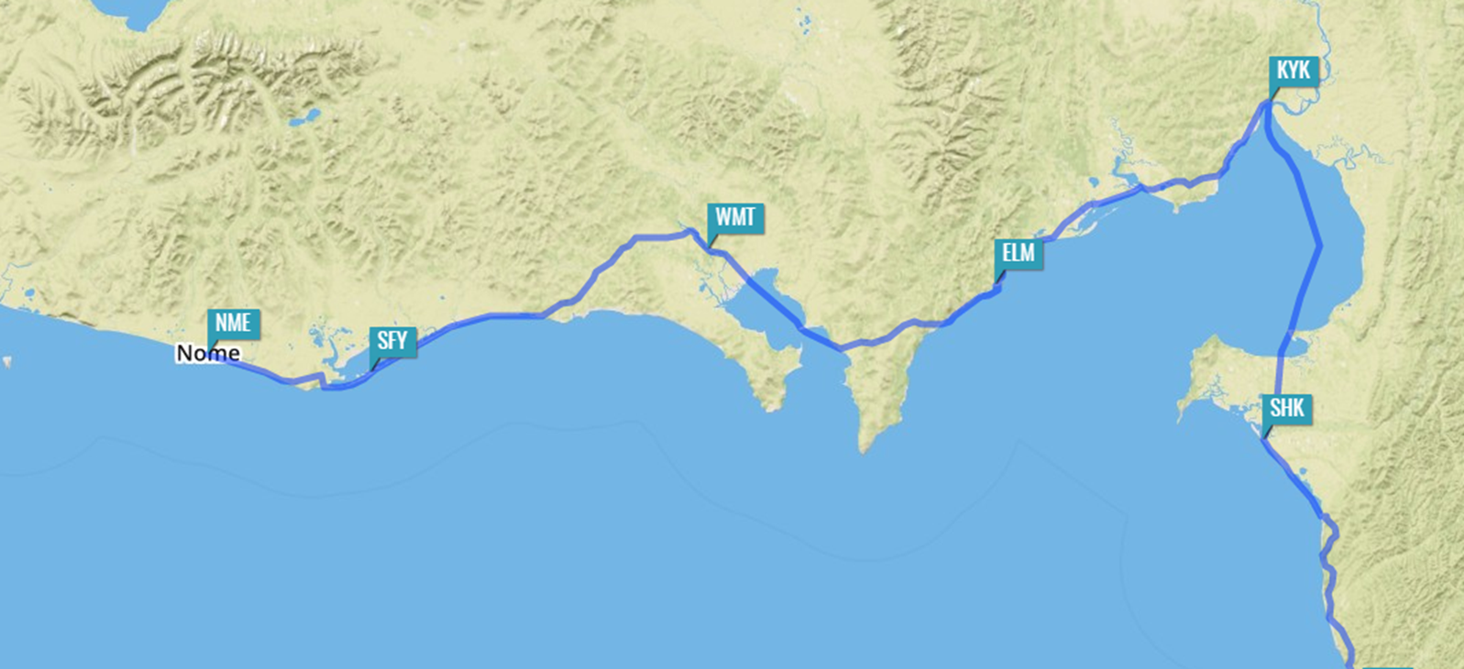
Label the landforms and water on this part of the trail.

