Slide 1
Mini Musher Bibs
Secret Forest Playschool

Slide 2
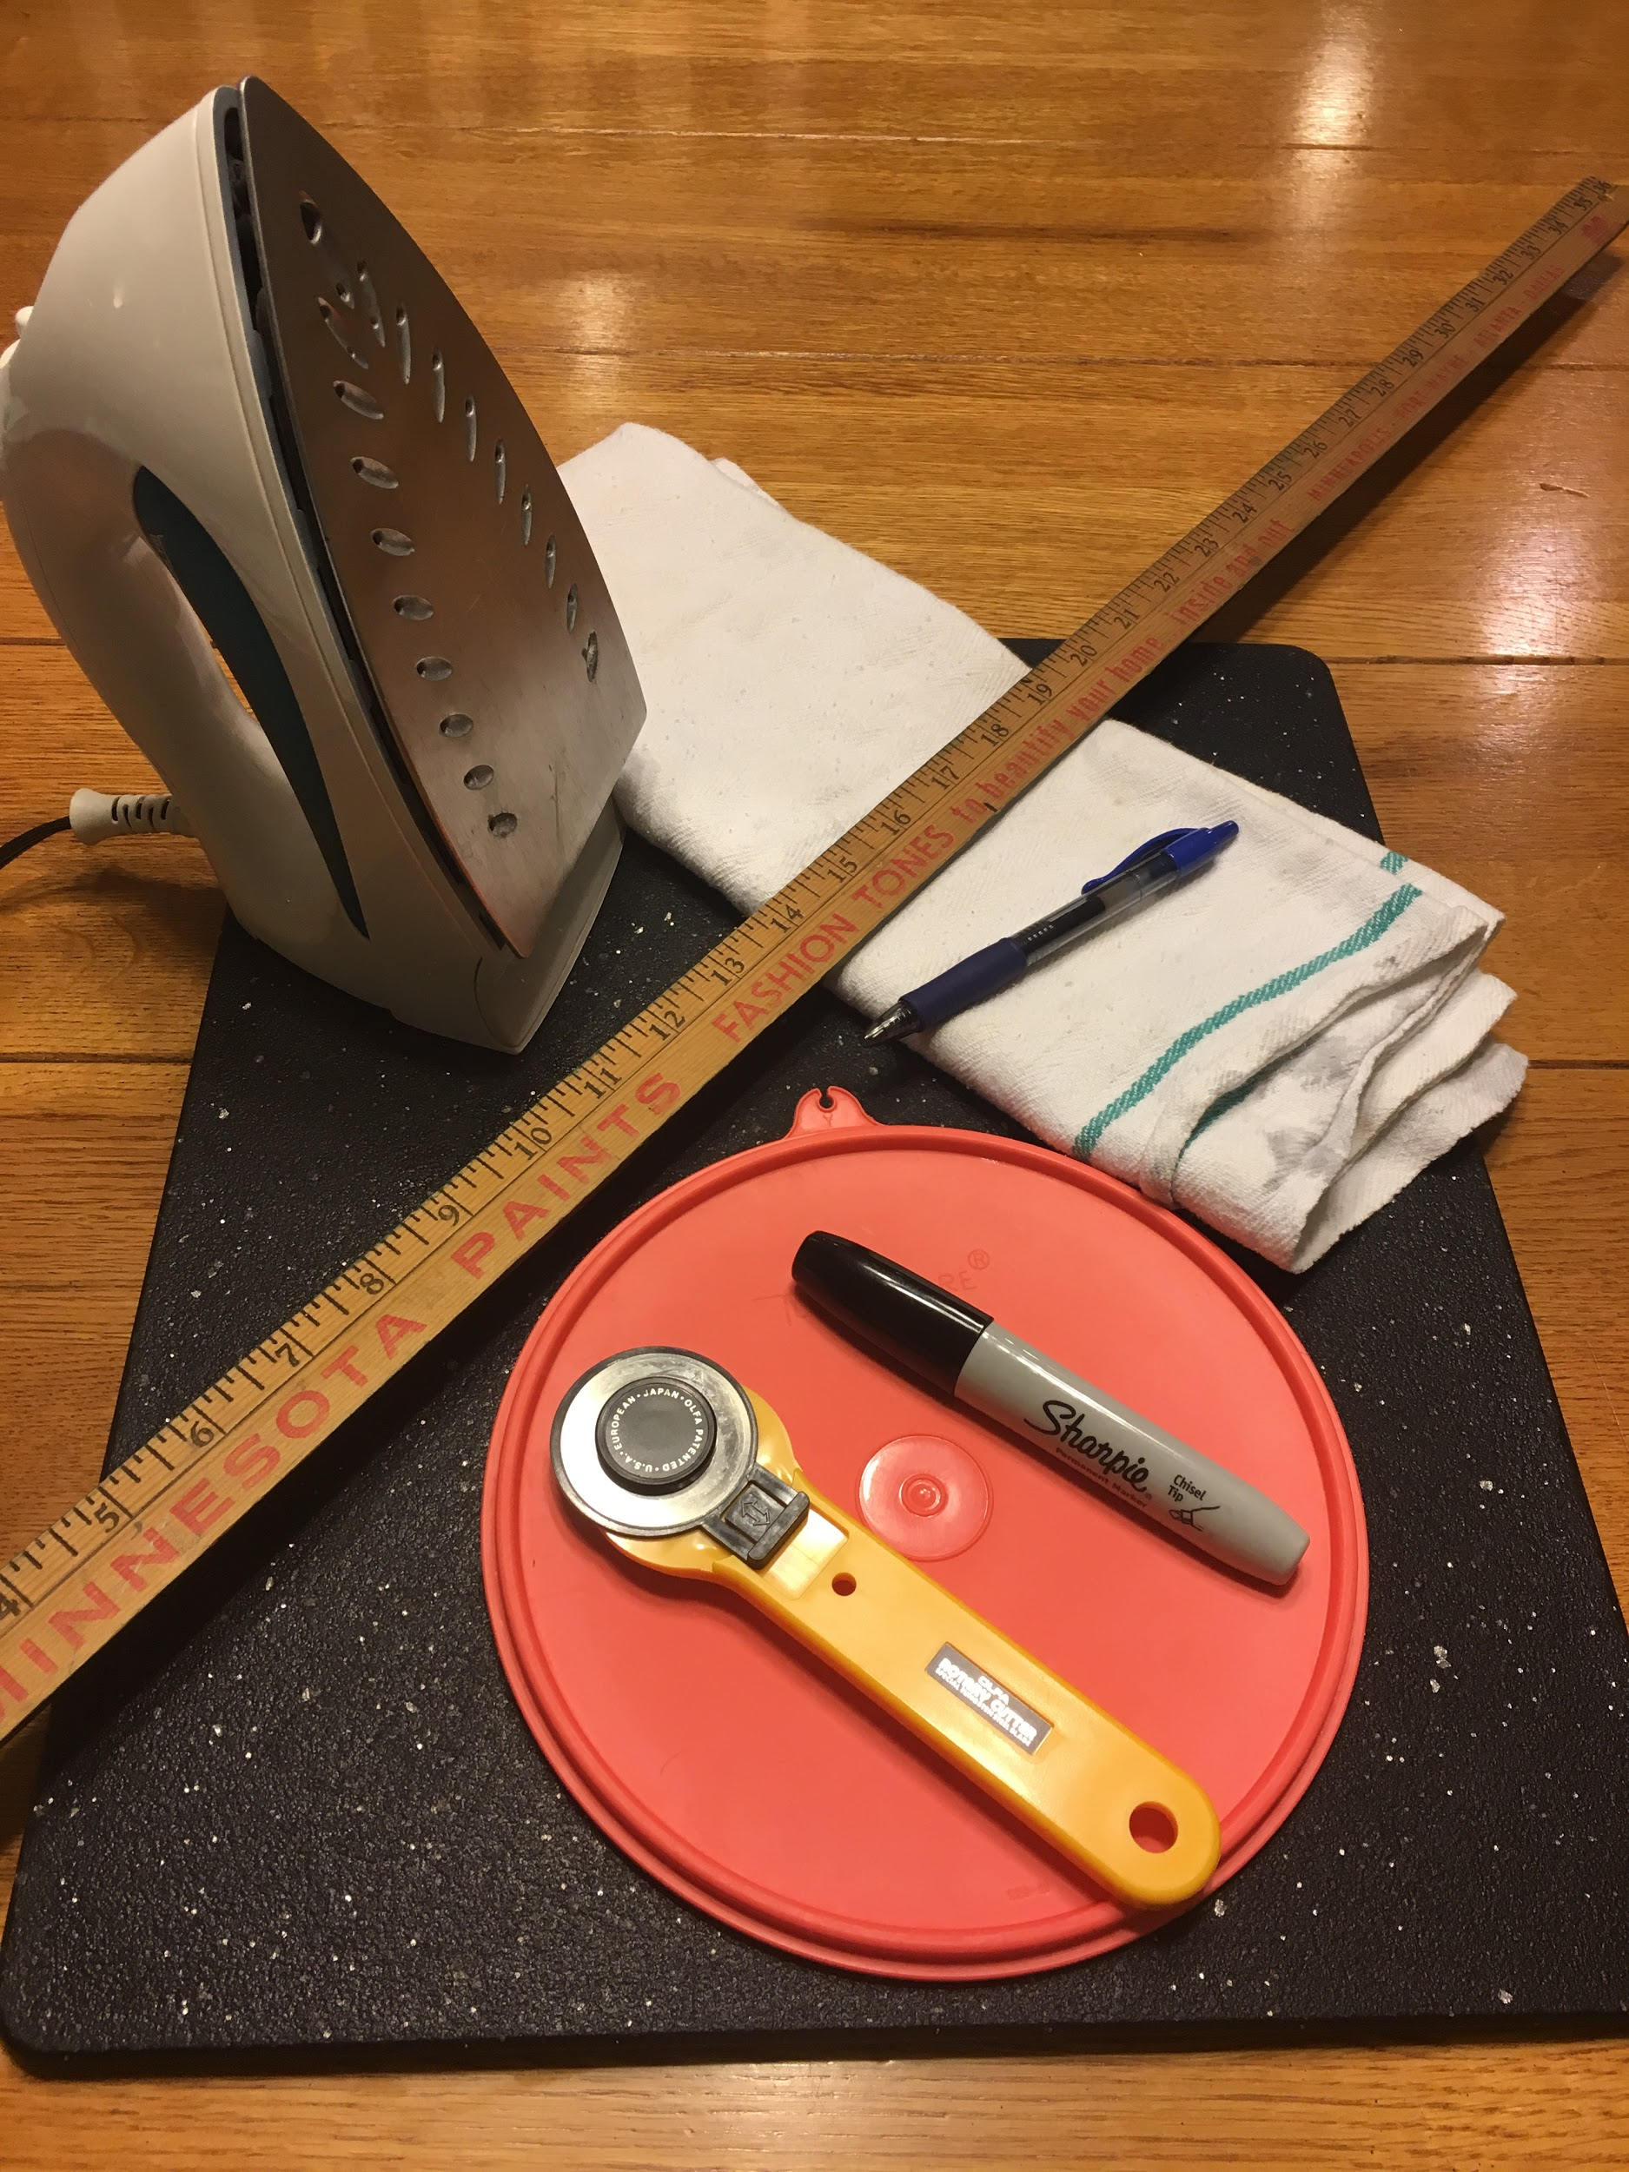
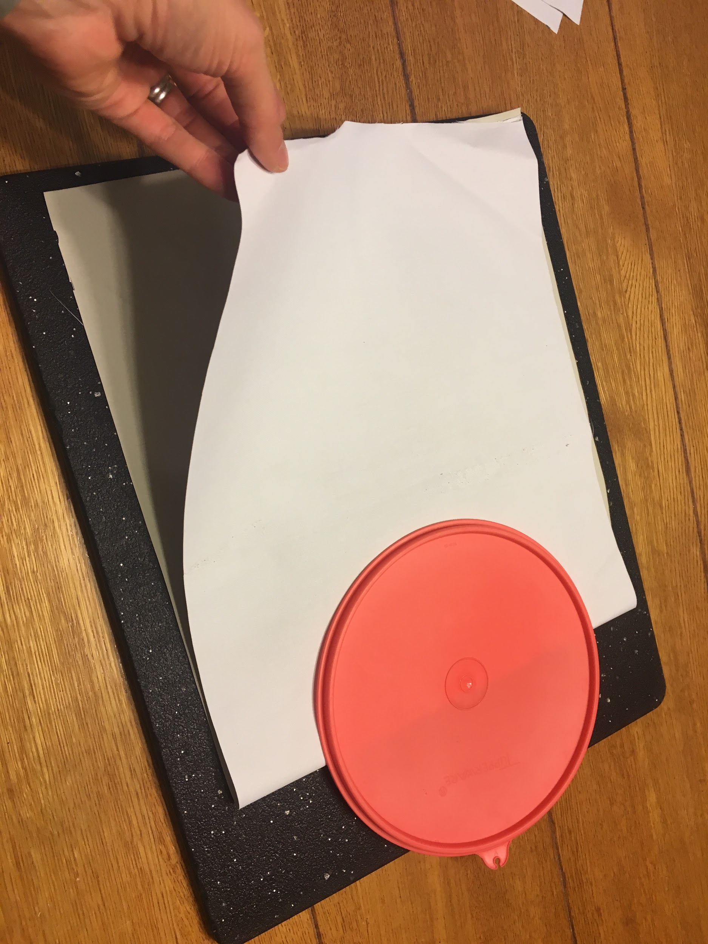
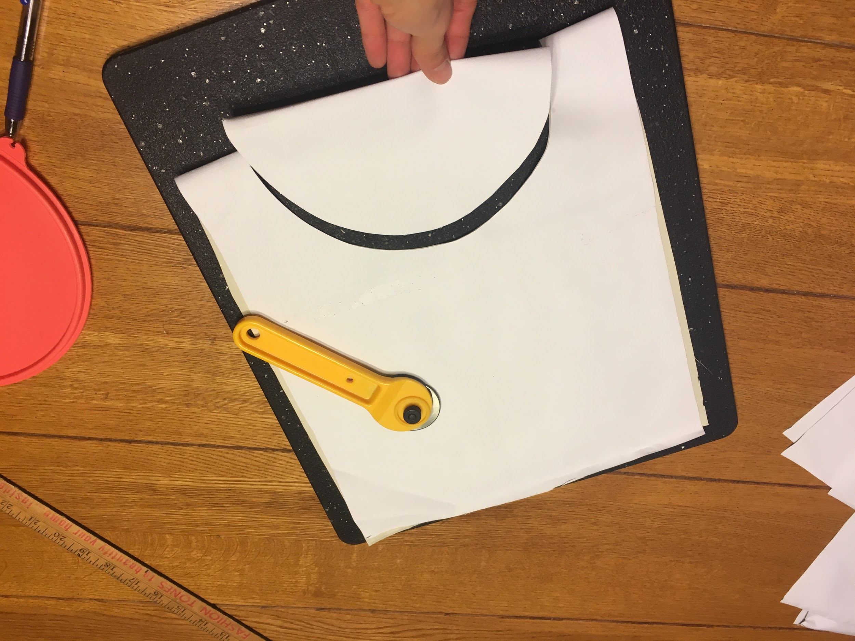
Materials and first steps- teacher prep

Slide 3
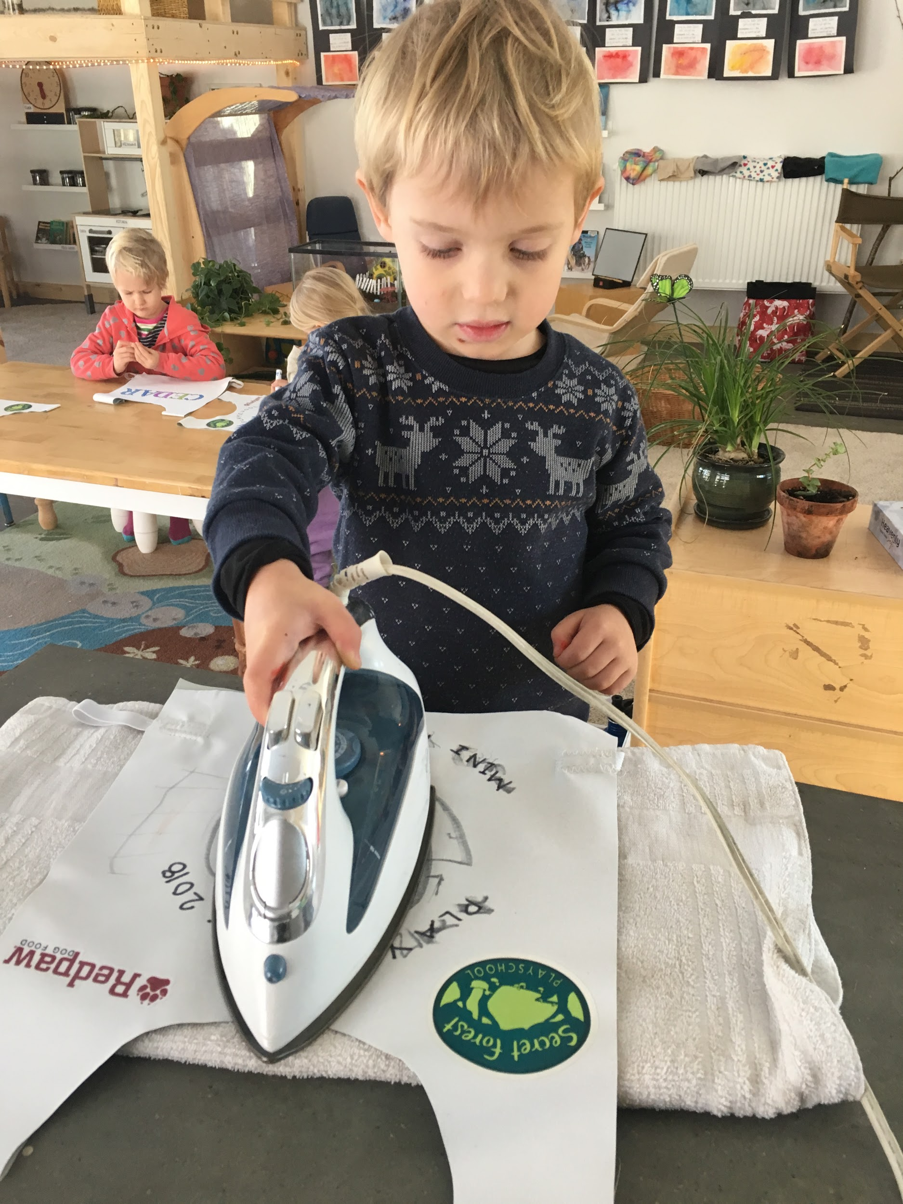
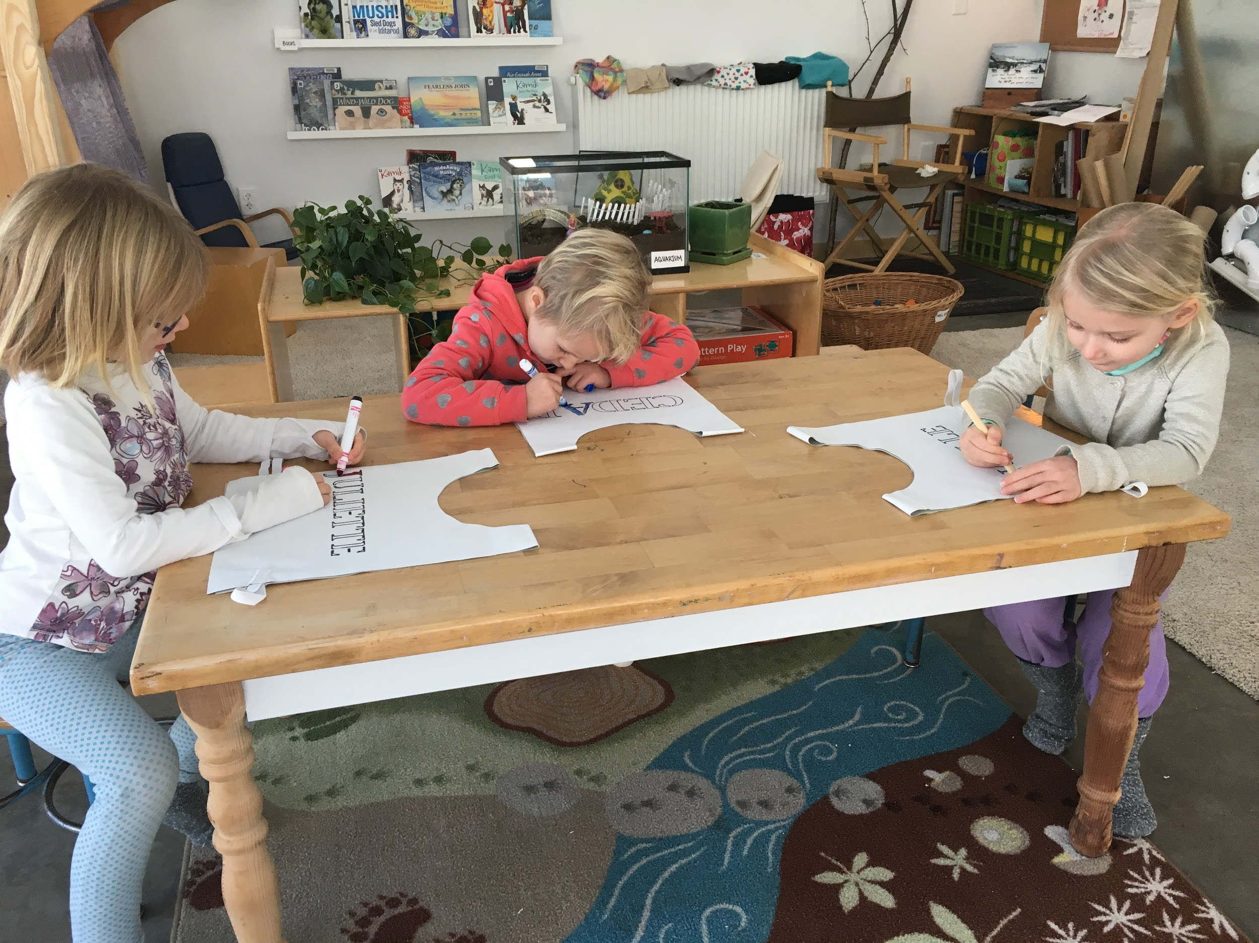
Ironing on race numbers and decorating race bibs

Slide 4
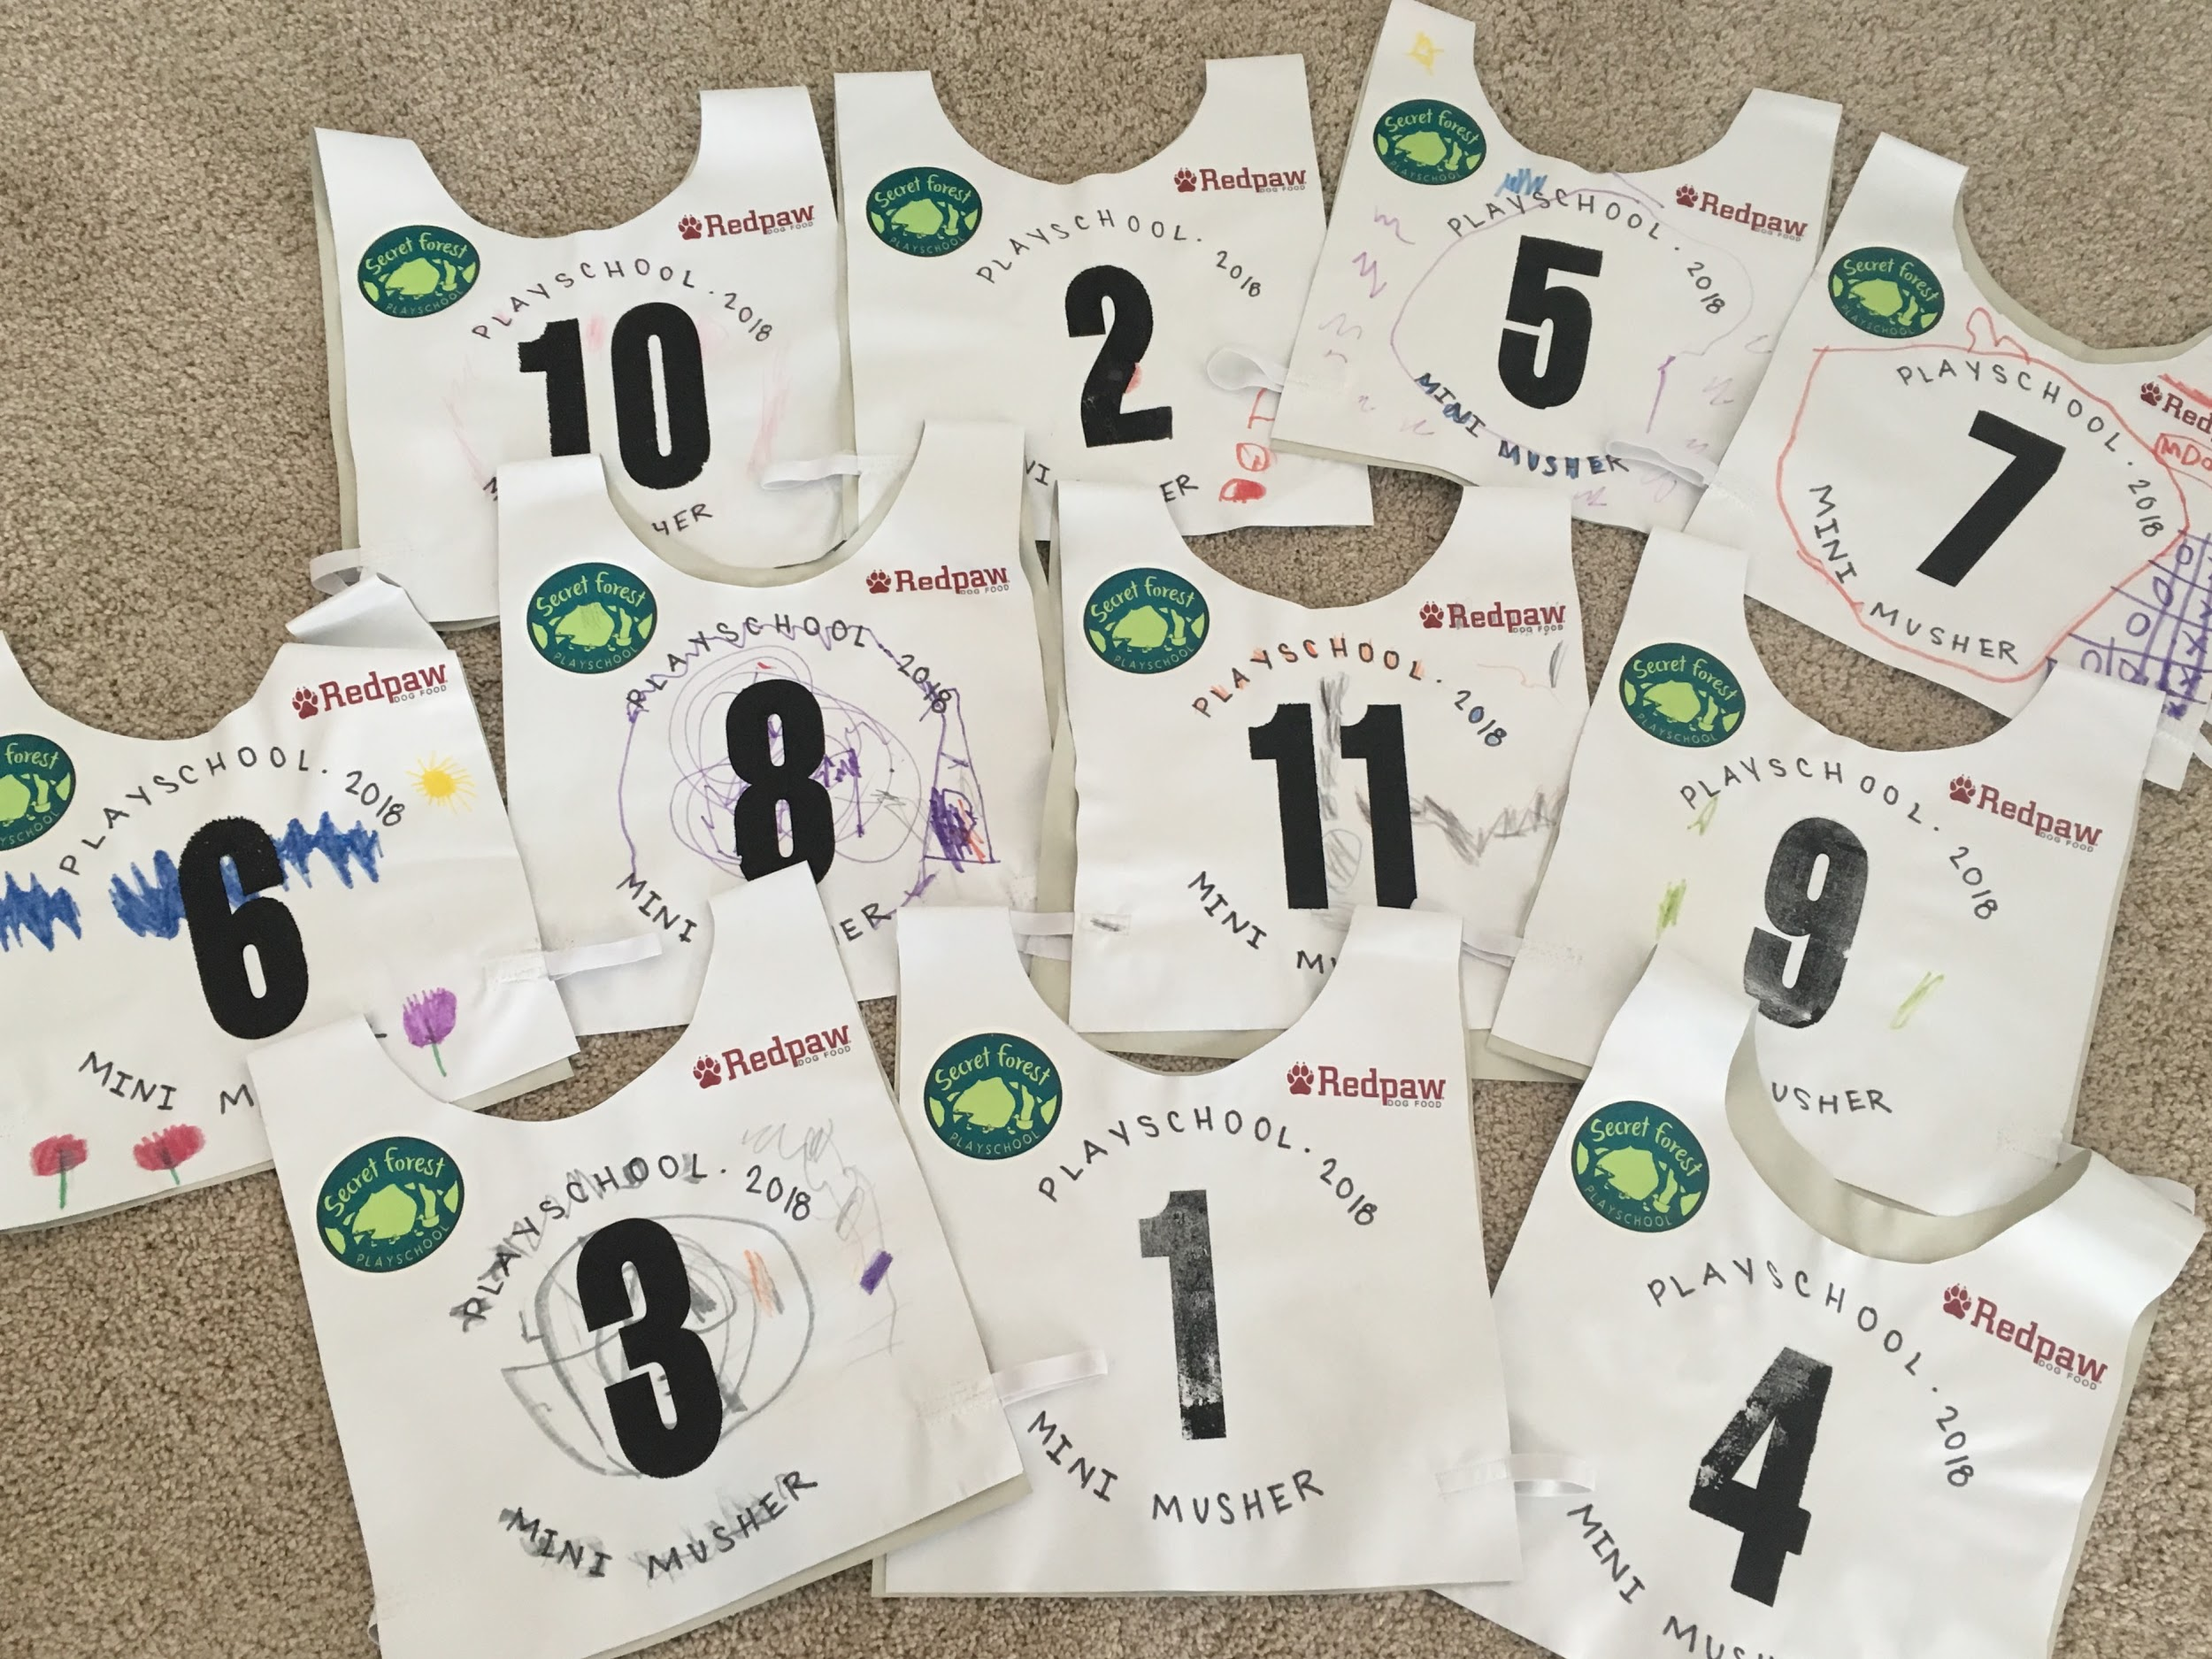
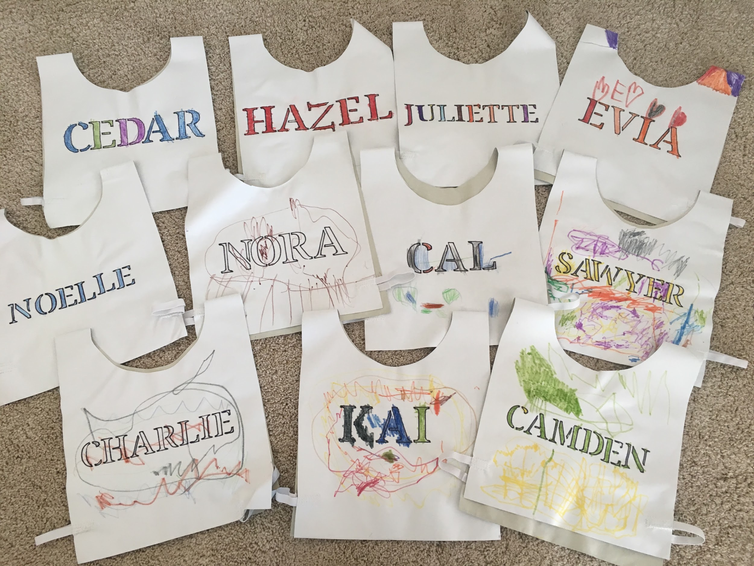
Front and back views.

Slide 5
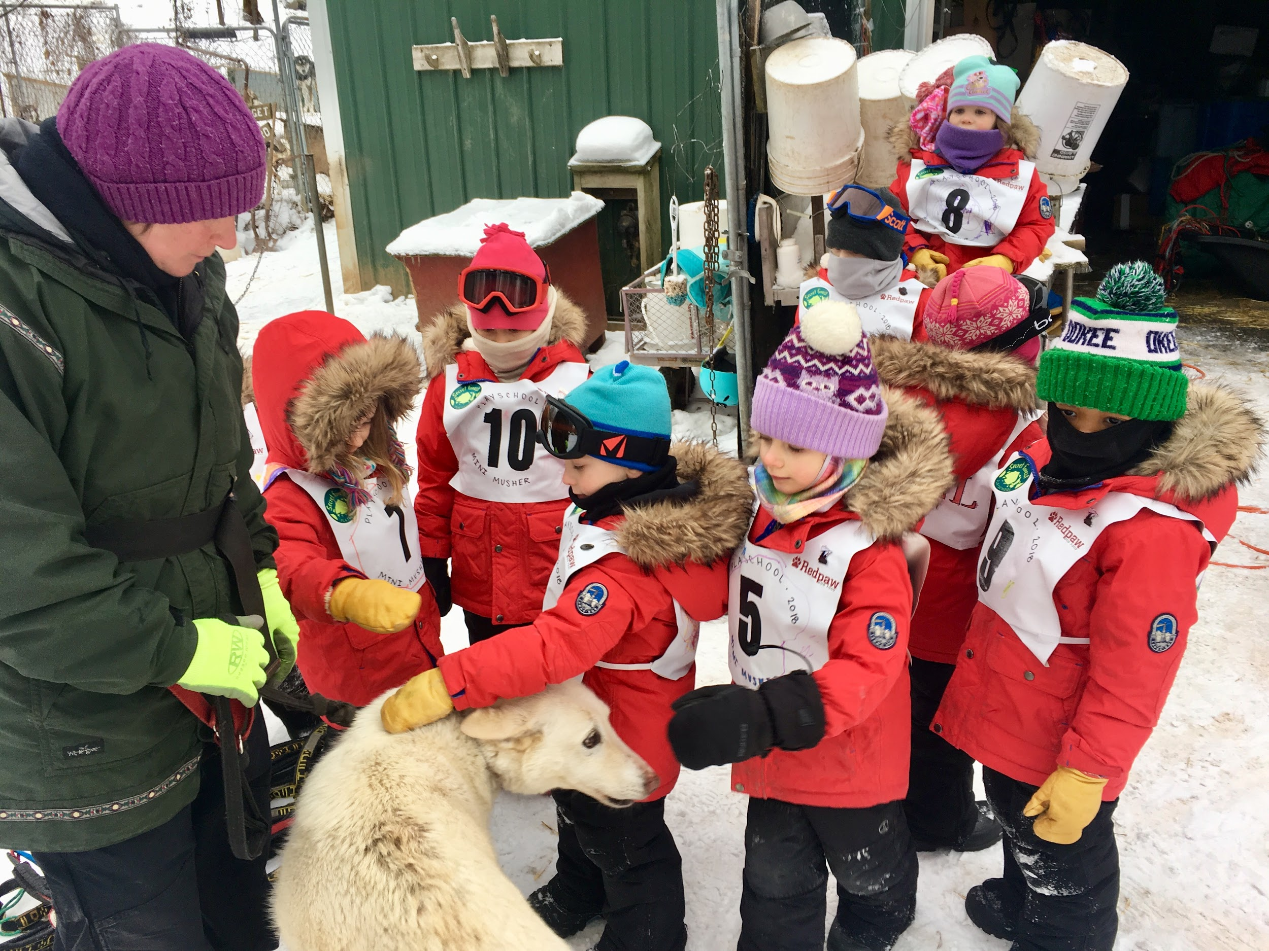
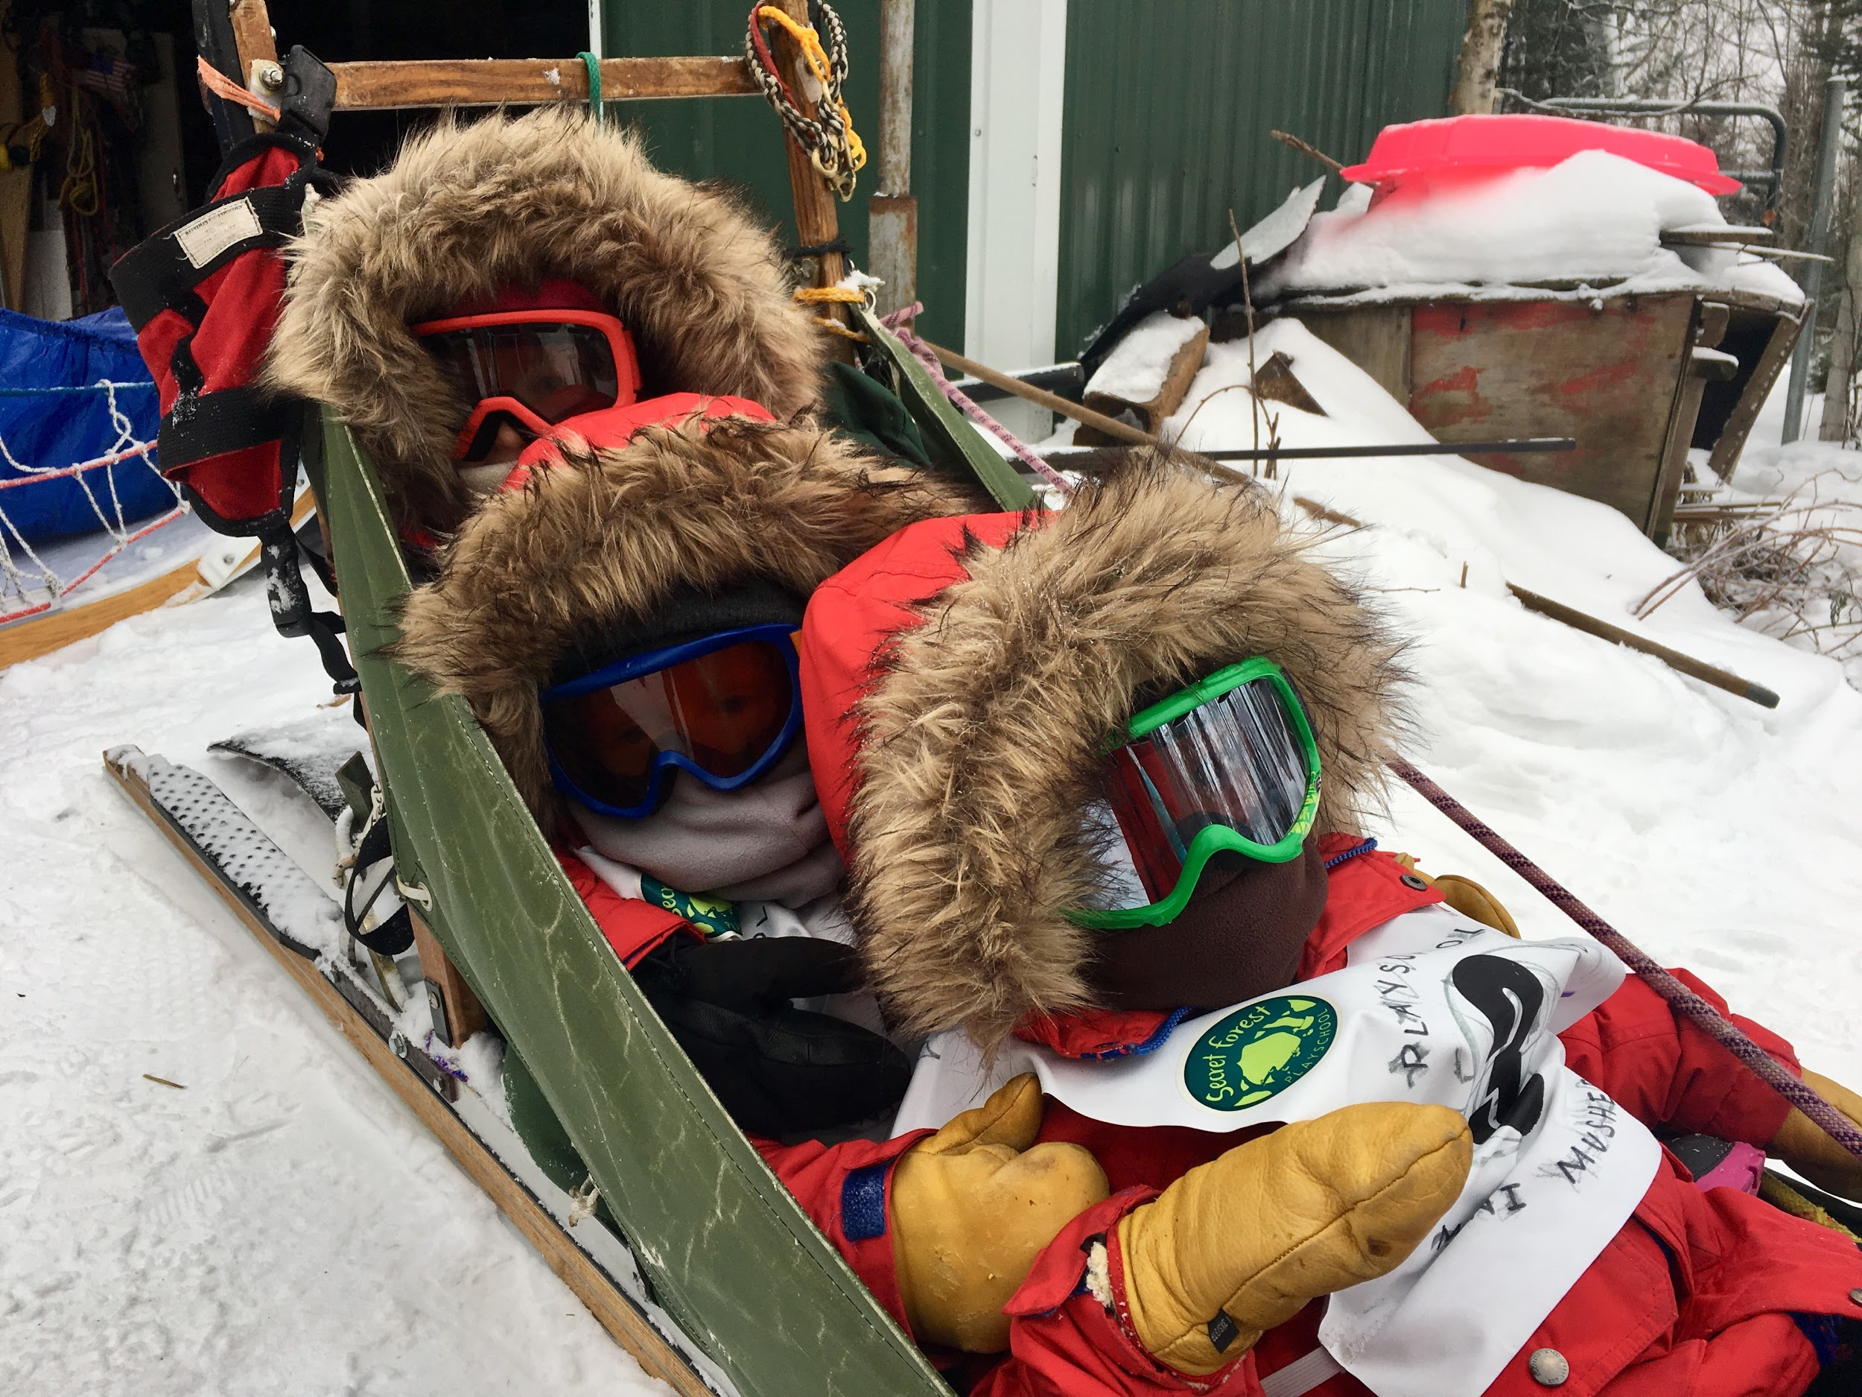
Dog sledding field trip to Positive Energy Outdoors

Slide 6
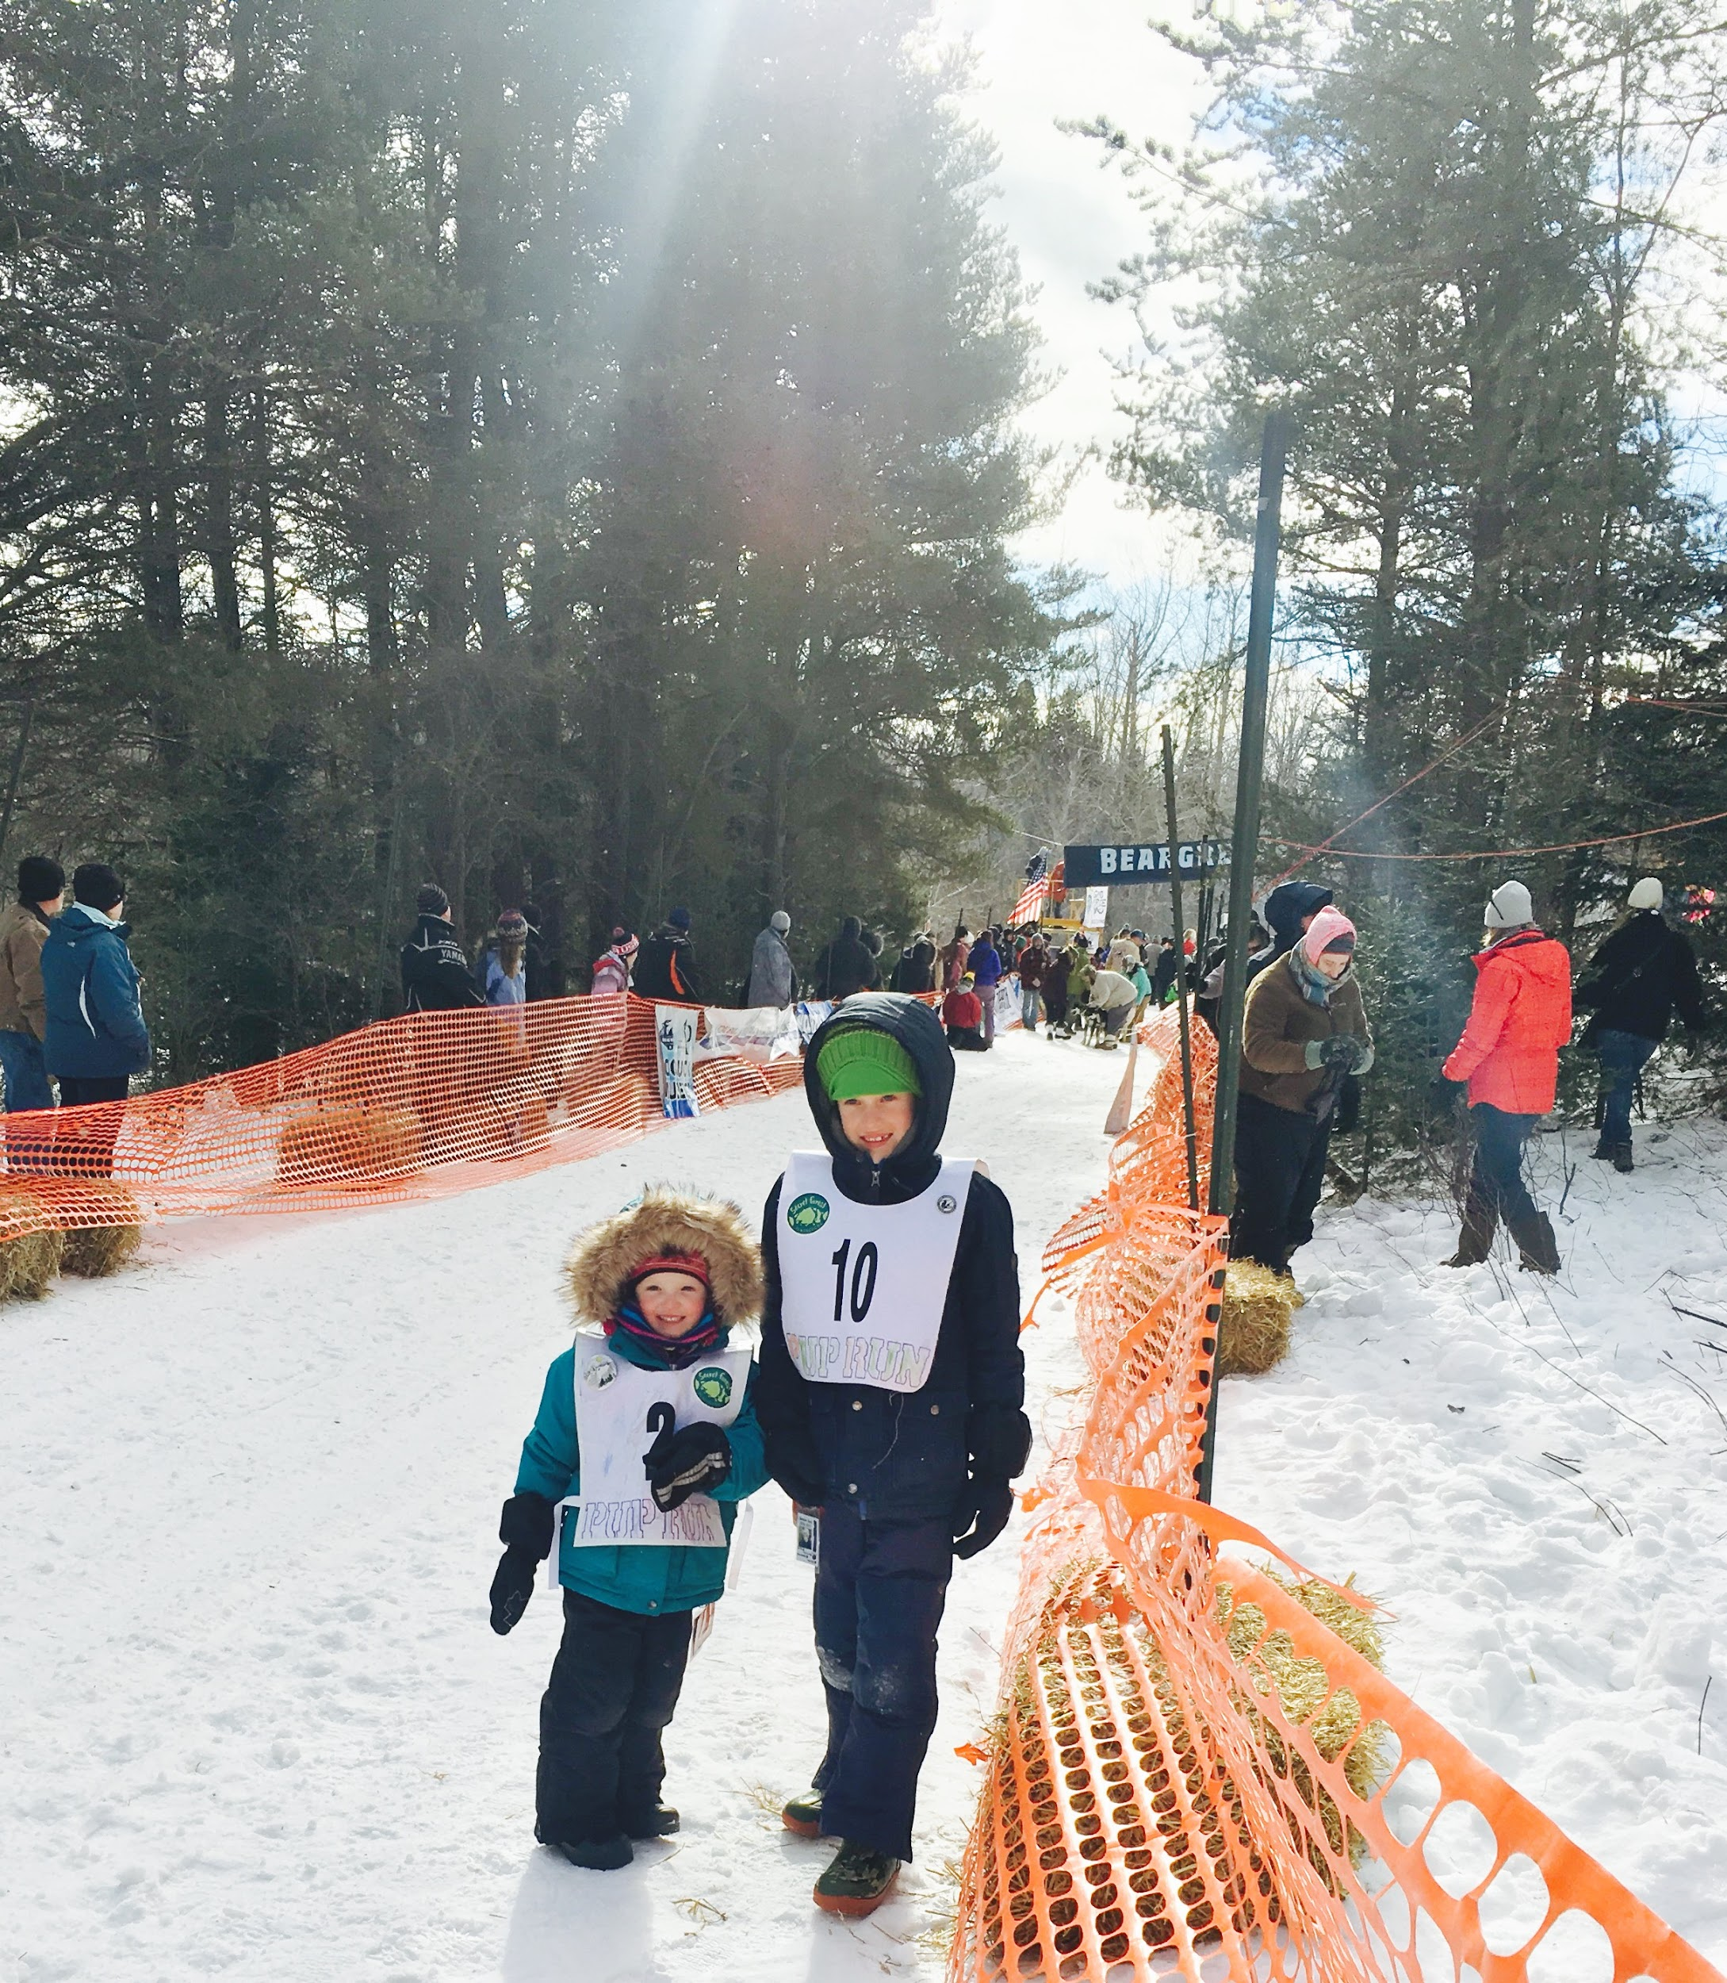
Mini Mushers wearing their bibs to the start of the Beargrease

Slide 7
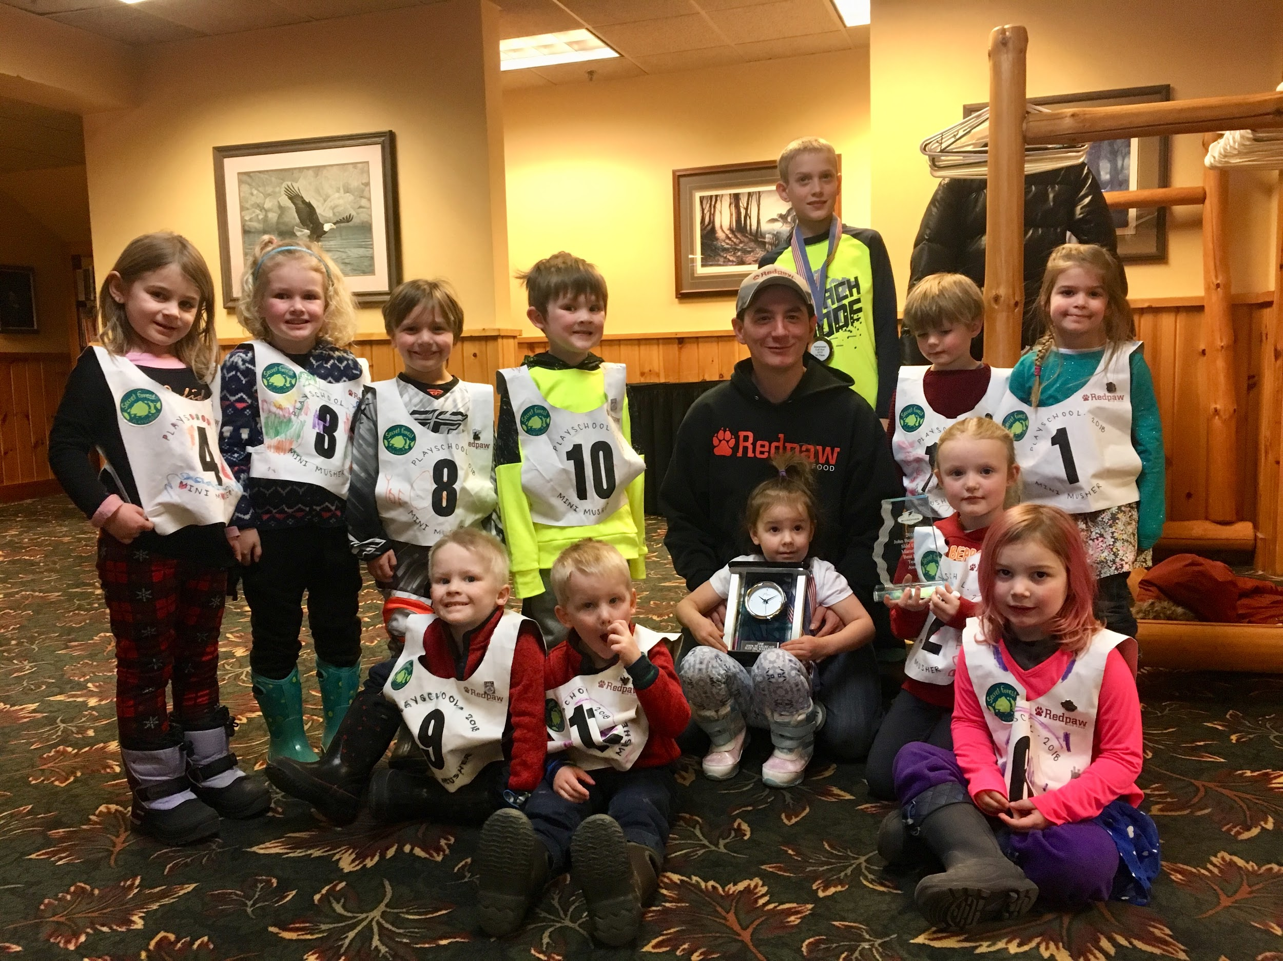
SFP’s Mini Mushers attended the Beargrease Banquet and got a picture with Ryan Redington- 1st place finisher and winner of the Humanitarian Award

Slide 8
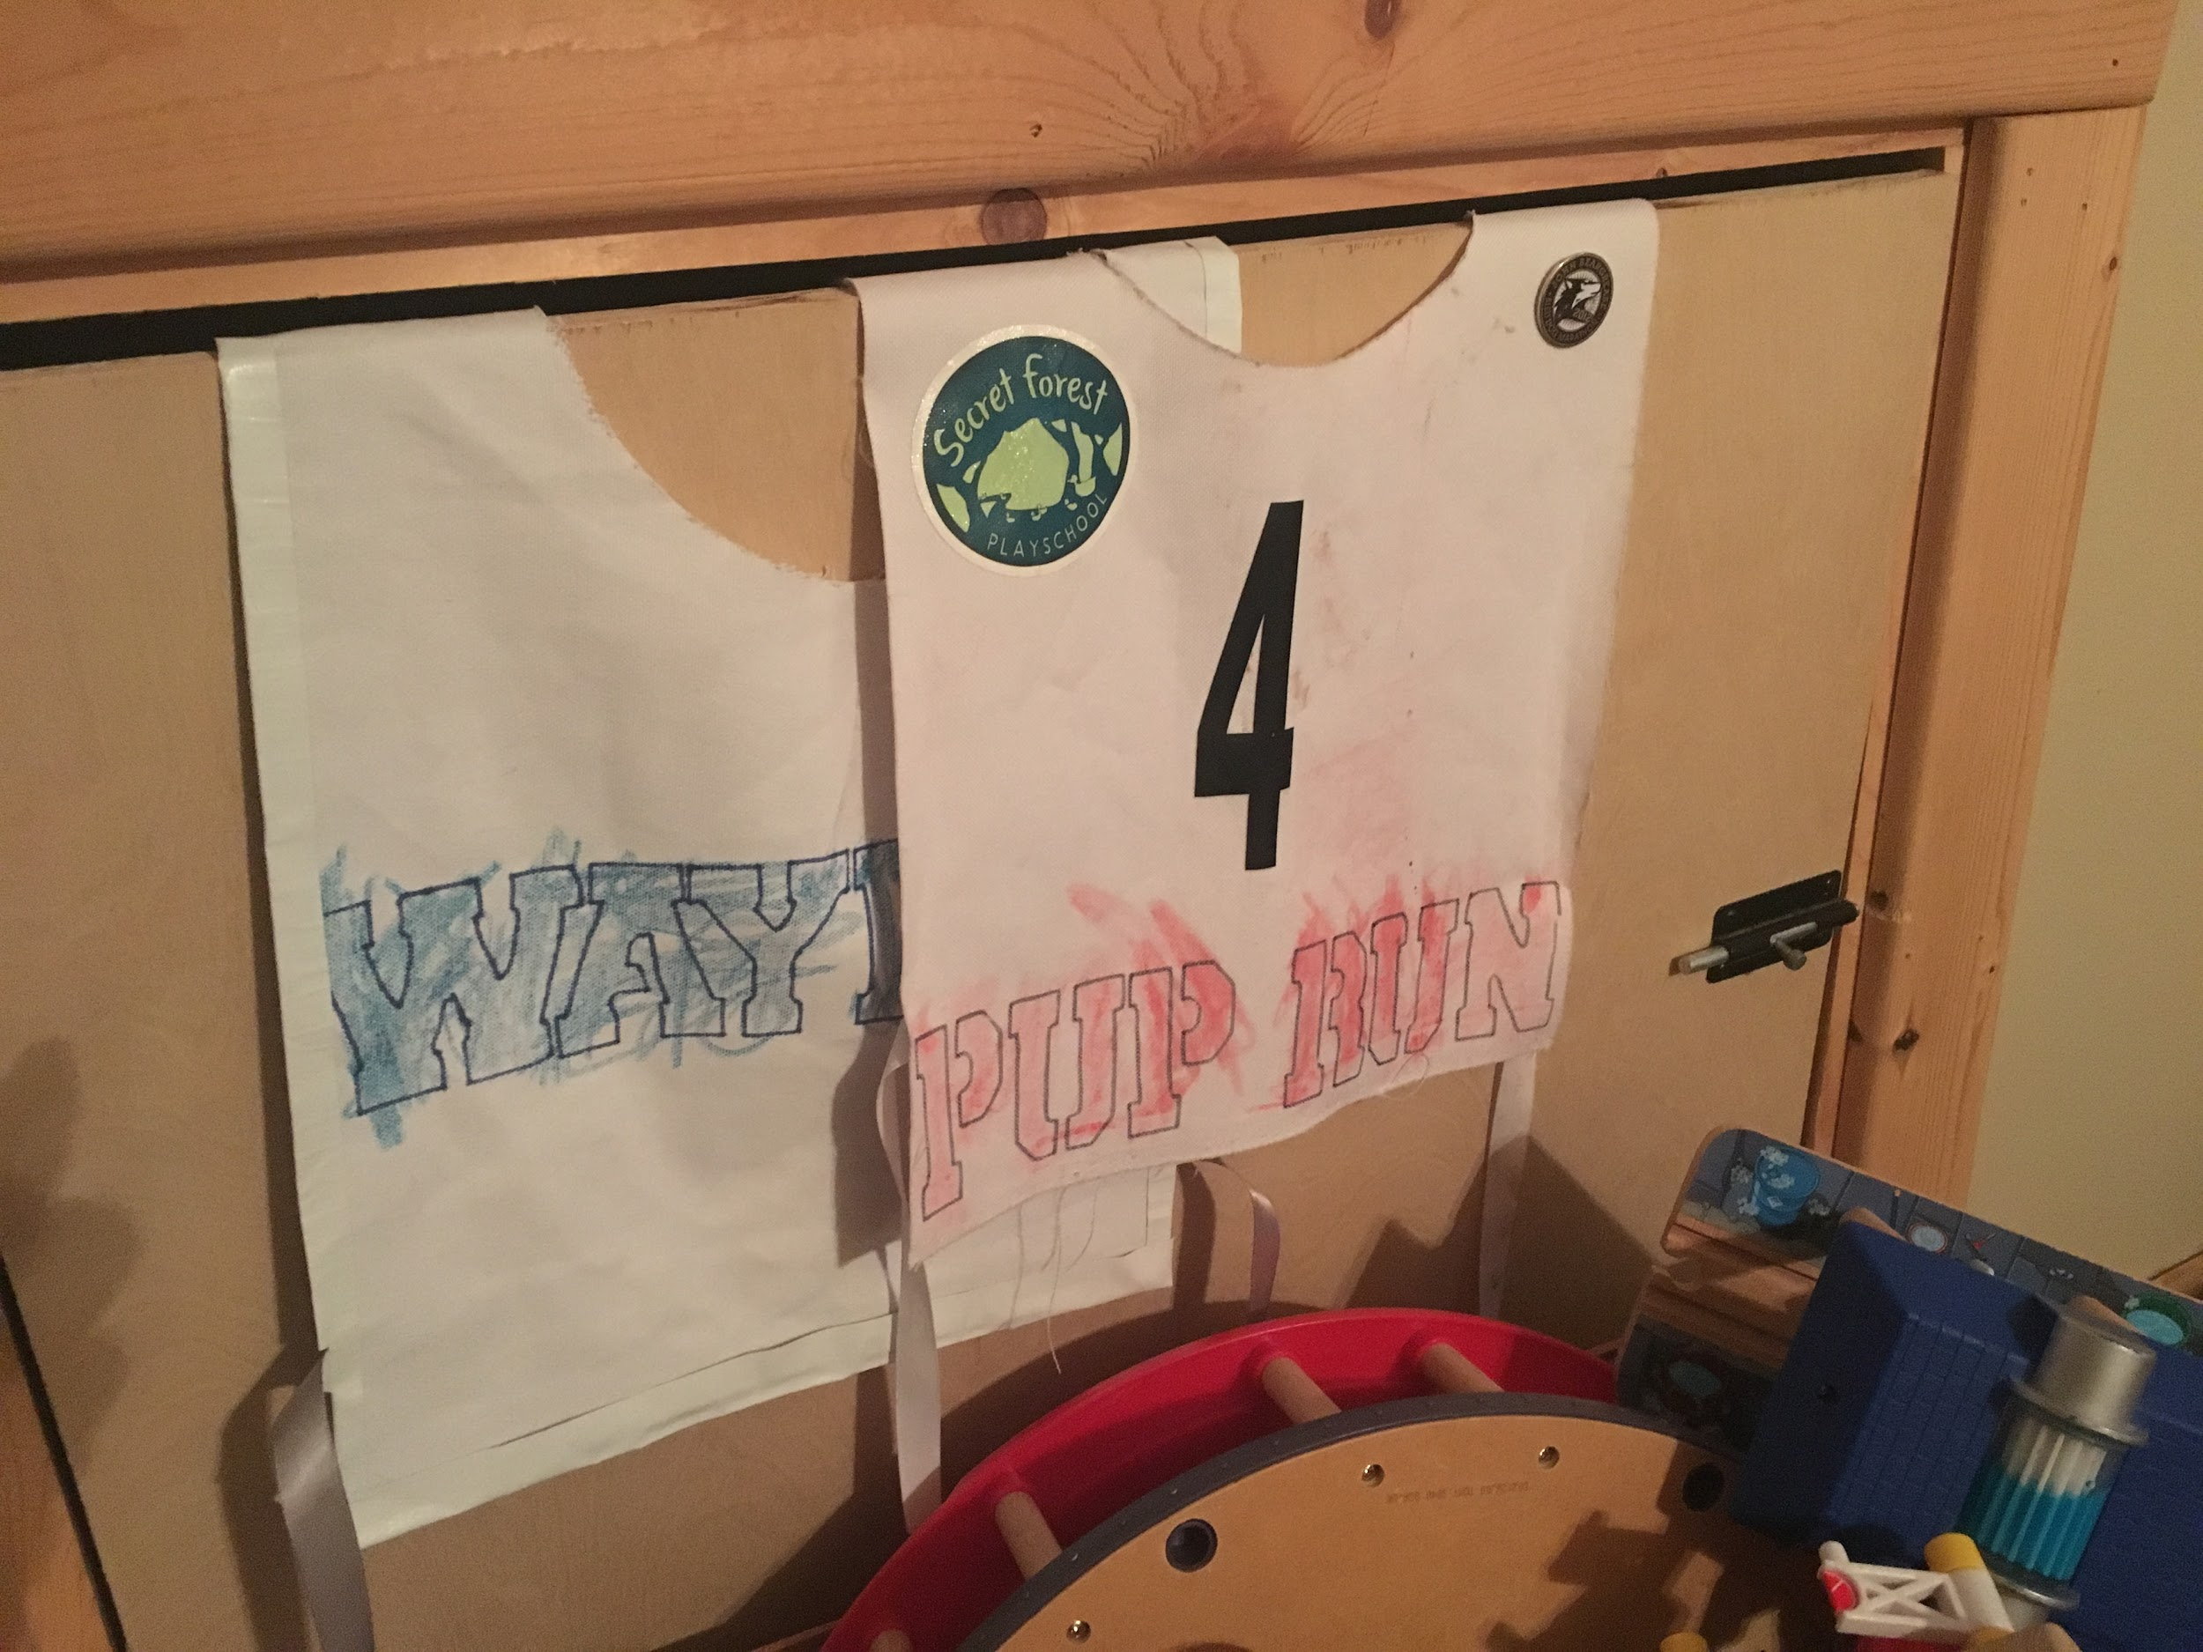
3 years after leaving Playschool, I spotted these hanging in one of my former student’s bedrooms- pretty sweet that these are still being treasured.

